Slide 1
Lecture 13:
3.5. American Ascendancy
Brad DeLong
Department of Economics and Blum Center, U.C. Berkeley; and WCEG
last revised: 2020-03-10
for presentation: 2020-03-10
Original course by Melissa Dell (Harvard Econ 1342), revised by Brad DeLong
<https://github.com/braddelong/public-files/blob/master/econ-135-lecture-13.pptx>

Slide 2
Big Ideas: Lecture 12: Modern Economic Growth
Takeaways from last lecture:
Give me five…

Slide 3
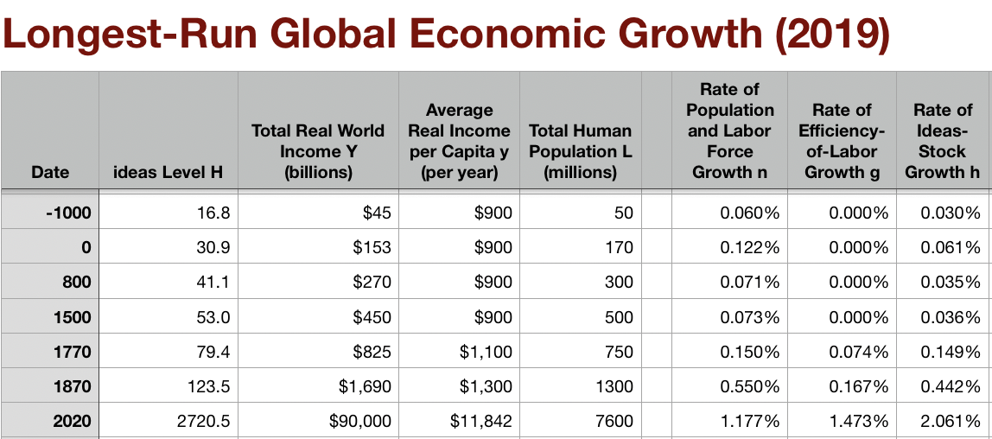
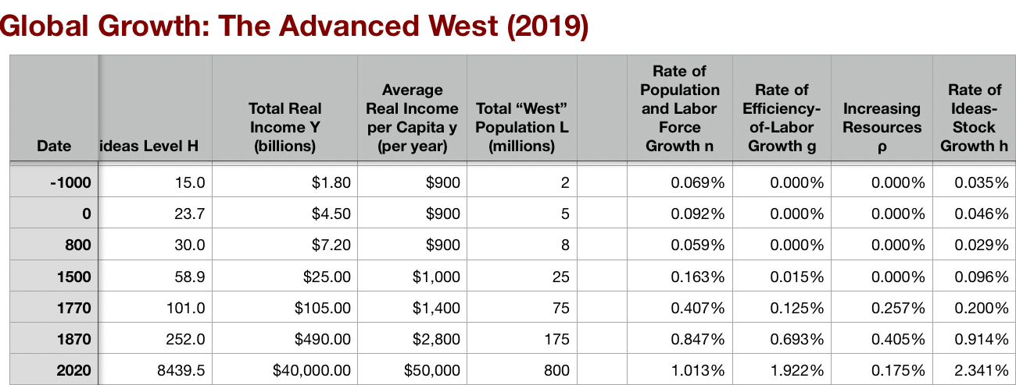
American Ascendancy
From Carl Sandburg: “Chicago (1916)
Hog Butcher for the World, Tool Maker, Stacker of Wheat, Player with Railroads and the Nation's Freight Handler; Stormy, husky, brawling, City of the Big Shoulders: They tell me you are wicked and I believe them, for I have seen your painted women under the gas lamps luring the farm boys. And they tell me you are crooked and I answer: Yes, it is true I have seen the gunman kill and go free to kill again. And they tell me you are brutal and my reply is: On the faces of women and children I have seen the marks of wanton hunger And having answered so I turn once more to those who sneer at this my city, and I give them back the sneer and say to them: Come and show me another city with lifted head singing so proud to be alive and coarse and strong and cunning…. Laughing the stormy, husky, brawling laughter of Youth, half- naked, sweating, proud to be Hog Butcher, Tool Maker, Stacker of Wheat, Player with Railroads and Freight Handler to the Nation.
3:10
Notes:
From Carl Sandburg, “Chicago” (1916):
Hog Butcher for the World,
Tool Maker, Stacker of Wheat,
Player with Railroads and the Nation's Freight Handler;
Stormy, husky, brawling,
City of the Big Shoulders:
They tell me you are wicked and I believe them, for I have seen your painted women under the gas lamps luring the farm boys.
And they tell me you are crooked and I answer: Yes, it is true I have seen the gunman kill and go free to kill again.
And they tell me you are brutal and my reply is: On the faces of women and children I have seen the marks of wanton hunger.
And having answered so I turn once more to those who sneer at this my city, and I give them back the sneer and say to them:
Come and show me another city with lifted head singing so proud to be alive and coarse and strong and cunning….
Laughing the stormy, husky, brawling laughter of Youth, half-naked, sweating, proud to be Hog Butcher, Tool Maker, Stacker of Wheat, Player with Railroads and Freight Handler to the Nation.

Slide 4

The 1870 Growth Inflection Point
Growth in global living standards 1870-1914 came largely as a surprise:
Over 1870-1914, year by year, real wages rose across the globe
Structural transformation
The diffusion of industrial technologies—to Des Moines IO & Birmingham AL, but also to Vienna, Cracow, and Barcelona
And demand from the growing industrial North Atlantic core for “tropical” commodities
Five factors in play:
Invention of invention: industrial research lab
Routinization and bureaucratization of technology diffusion: the modern corporation
Globalization
In goods trade
In communication
In migration
Fair to say this half-century was not foreseen, and was viewed at the time and in retrospect as miraculous. (Cf.: Keynes, Economic Consequences of the Peace.)
2:40
Notes:
In the world’s North Atlantic region every year between 1870 and 1914 saw populations rise; agricultural labor productivity improve; farmers pushed out of agriculture where they were no longer needed and pulled into mining, manufacturing, and urban services where they were; and technology diffuse as people in Des Moines, Iowa and Birmingham, Alabama but also Vienna, Cracow, and Barcelona learned how to apply the industrial technologies invented in Manchester, London, Liege, and Lowell, Massachusetts. Most important, every year between 1870 and 1914 saw newer and better industrial technologies emerge from the first industrial research laboratories ever.
Pre-World War I patterns of growth are, I think, beset read as the working-out of the economic, political, and technological logic of the—relatively sudden, around 1870—creation of the first true global economy. Starting from a still largely very poor and overwhelmingly pre-industrial world, by the late nineteenth century transportation costs had finally fallen low enough and transport speeds had become high enough to make mass intercontinental shipment of goods and people possible. Moreover, communications had improved to such a degree that the world truly became one world in that you could wrap a single organization across the globe and expect it to work. Thus these improvements in transportation and communication had for the first time created the possibility of a global economy—an economy in which movements of people and goods across oceans and between continents were central to how the economy worked, rather than mere precious and luxury froth on the surface of a deep ocean. Combine those with the invention of invention—the coming of science to technology—and we have the pre-World War I world, in the North Atlantic, at least.
This by and large came as a surprise. Indeed, it is fair to say that as of 1870 the idea that modern economic growth would take hold and grip the world was still a fringe, utopian one—more-or-less confined to dreamers and socialists, and not even all of them.

Slide 5
The Industrial Revolution Did Not Light Off the Rocket
Key was that the British Industrial Revolution led to the invention of invention
The technologies of steam, textile machinery, ironworking, & railroads were great
They were not transformative
World in 1870 still desperately poor
Not at all clear world in 1870 would see technology outrun fecundity
Any slowdown in further technological development would return humanity to its Malthusian prison
And there had been other largely-local “efflorescences” before that had ended in jumps in population rather than in living standards and labor productivity
1870 as the watershed
The invention of invention: the industrial research lab
The routinization and bureaucratization of technology diffusion: the modern corporation
After 1870, technology outruns fecundity and then fecundity gives up the race
3:15
Notes:
But the original steam-iron-and-cotton Industrial Revolution, it turned out, was not just a lucky set of individual inventions but instead had set in motion something truly new: the invention of invention and innovation. By 1870 it had created the industrial research lab to routinize, rationalize, and bureaucratize the processes of research and development. By 1870 it had created the modern corporation to deploy the technologies produced in the research labs. The new industrial economy created by the Industrial Revolution could be counted on to throw out additional innovations of the same magnitude as the railroad and the power spindle at least once a generation. That is what lit the rocket of modern economic growth.
Why was there, as economist W. Arthur Lewis recognized, something fundamentally different after 1870? Before 1870 inventions and innovations—those of the “classic” agricultural and industrial revolutions”—were discoveries and adaptations that produced new and better ways of doing old things: of making thread, of weaving cloth, of carrying goods about, of making iron, of raising coal, and of growing wheat and rice and corn. The steam engine of the eighteenth century required precision metalworking to make the boilers and the pistons and the pipes strong enough not to burst, and the valves smooth enough to function. This came about because of western Europe's four-century love affair with iron, copper and gunpowder: the making of firearms was the womb of the metal-bashing technologies that are at so much of the core of our industrial civilization.
The steam engine of the eighteenth century also required something really important for a steam engine to do. That need was found in the necessity of keeping coal mines from flooding. And the steam engine of the eighteenth century also required a really cheap source of heat. That was found at the bottom of the coal mines where the flooding was taking place, for where could energy possibly be cheaper than at the bottom of a coal mine? Without this confluence—skilled metalworking harnessed to the service of pumping water out of the place where coal was most abundant—it is hard to see there being an eighteenth-century technological-industrial revolution in England that produced the steam engine.
With the steam engine, with cheap plantation-grown cotton ideally suited for machine spinning, and with practical metallurgy to make iron rails and iron wheels cheaply, the fuse that was the industrial revolution was lit. Steam power propelled the automatic spindles, looms, metal presses, and railroad locomotives of the nineteenth century. But the fuse might well have sputtered out before it lit the rocket—as printing, the windmill, the musket, the seagoing caravel, and before then the watermill, the horse collar, the heavy plow, the legion, the olive press, and so forth had sputtered out before they lit the rocket of modern economic growth. Each of these did revolutionize their piece of the economies of their day. Yet none of them lit off the rocket we have ridden since 1870—as the British Industrial Revolution proper did.

Slide 6
The Creation of Engineering & Management, & the 1870-1914 Belle Époque
Economic historians Robert Allen and Arthur Lewis on the secret byproduct of the British Industrial Revolution
Allen: “The great achievement of the British Industrial Revolution was... the creation of… engineering…. Machinery production was the basis of three developments... (1) the general mechanization of industry; (2) the railroad; and (3) steam-powered iron ships. The first raised productivity... the second and third created the global economy and the international division of labor.... All three... depended on...: the steam engine and cheap iron.… Technologies invented [elsewhere—for example]… paper production, glass, and knitting [in France]—were not [transformative].... The British were... simply luckier in their geology…. [T]here is no reason to believe that French technology would have led to the engineering industry, the general mechanization of industrial processes, the railway, the steamship, or the global economy…”
Lewis: “[Invention] added a new twist—that of making new commodities: telephones, gramophones, typewriters, cameras, automobiles, and so on, a seemingly endless process whose latest twentieth-century additions include aeroplanes, radios, refrigerators, washing machines, television sets, and pleasure boats. Thus a rich man in 1870 did not possess anything that a rich man of 1770 had not possessed; he might have more or larger houses, more clothes, more pictures, more horses and carriages, or more furniture than say a school teacher possessed, but as likely as not his riches were displayed in the number of servants whom he employed rather than in his personal use of commodities…”
3:15
Notes:
The technologies of the British Industrial Revolution did not just revolutionize power, transport, and textiles but had an even more important and unforeseen byproduct. As economic historian Robert Allen has written:
>The nineteenth century was different… the great achievement of the British Industrial Revolution was... the creation of… engineering…. Machinery production was the basis of three developments... (1) the general mechanization of industry; (2) the railroad; and (3) steam-powered iron ships. The first raised productivity... the second and third created the global economy and the international division of labor.... All three... depended on...: the steam engine and cheap iron.… Technologies invented [elsewhere—for example]… paper production, glass, and knitting [in France]—were not [transformative].... The British were... simply luckier in their geology…. [T]here is no reason to believe that French technology would have led to the engineering industry, the general mechanization of industrial processes, the railway, the steamship, or the global economy.…
Add one more key: cotton, especially cheap cotton, especially cheap slave-grown American cotton. Coal-steam-cotton-spindle-loom-rail lit the rocket. And, as W. Arthur Lewis wrote, the process of modern economic growth spread after 1870 because invention:
>added a new twist—that of making new commodities: telephones, gramophones, typewriters, cameras, automobiles, and so on, a seemingly endless process whose latest twentieth-century additions include aeroplanes, radios, refrigerators, washing machines, television sets, and pleasure boats. Thus a rich man in 1870 did not possess anything that a rich man of 1770 had not possessed; he might have more or larger houses, more clothes, more pictures, more horses and carriages, or more furniture than say a school teacher possessed, but as likely as not his riches were displayed in the number of servants whom he employed rather than in his personal use of commodities…
Not just a wave of particular innovations and inventions, but an ongoing process of continual technological advance: steel manufacture and chemical processing and oil wells and internal-combustion engines and vacuum processing and telegraphs and electric motors and the iron-hulled ocean-going steamship. This was the rocket that carried the world economy forward into the first period of broad-based, noticeable, worldwide, industrial growth ever: the Gilded Age, the Belle Époque of 1870-1914.

Slide 7
Review: The View from 3000: Themes & Big Ideas
In the Long 20th Century from 1870-2016:
Science reaches critical mass and from it springs engineering:
All of the engineering subdisciplines,
Including the management of human resources and of organizations.
From a liberal political order spring national and then the global market economy.
And from engineering and the market then, since 1870, springs enormous wealth.
The pace of growth of the value of the useful ideas stock quadruples looking across 1870: 1870-2016 sees growth at 2%/yr plus
In contrast to 0.5%/yr or so of the Industrial Revolution age 1770-1870
In contrast to the 0.15%/yr or so of the Commercial Revolution age 1500-1770
In contrast to the 0.035%/yr or so of the Agrarian age pre-1500
Nine aspects of 1870-2016 economic history:
Post-1870 history has been economic…
Explosion of wealth…
Cornucopia of technology…
Demographic transition…
Feminist revolution…
Empowered tyrannies…
Wealth gulfs…
Inclusion and hierarchy attenuation…
Mismanagement and insecurity…
3:10
Notes:
Time to review the Big Ideas of the history of the Long 20th Century:
In the Long 20th Century from 1870-2016:
Science reaches critical mass and from it springs engineering: All of the engineering subdisciplines, Including the management of human resources and of organizations.
From a liberal political order spring national and then the global market economy.
And from engineering and the market then, since 1870, springs enormous wealth.
The pace of growth of the value of the useful ideas stock quadruples looking across 1870: 1870-2016 sees growth at 2%/yr plus; In contrast to 0.5%/yr or so of the Industrial Revolution age 1770-1870; In contrast to the 0.15%/yr or so of the Commercial Revolution age 1500-1770; In contrast to the 0.035%/yr or so of the Agrarian age pre-1500
Nine aspects of 1870-2016 economic history are worth keeping permanenty in your brain:
1. Post-1870 history has been economic…
2. Explosion of wealth…
3. Cornucopia of technology…
4. Demographic transition…
5. Feminist revolution…
6. Empowered tyrannies…
7. Wealth gulfs…
8. Inclusion and hierarchy attenuation…
9. Mismanagement and insecurity…

Slide 8
Britain’s Relative Decline
The U.S. could become “the forge of the future” only because of Britain’s alarmingly rapid relative decline
Great Britain had been the first industrial nation:
Empire
Coal
Tinkering
Science
Market economy
Richest country in the world (save Austgralia) in 1870
And the most industrialized
Productivity growth sped up around 1870
But elsewhere—and in the world as a whole—productivity growth quadrupled
Why only a small acceleration? A focus on technologies that made heavy use of unskilled workers?
Lewis again: “In the last years of the nineteenth and the ﬁrst years of the twentieth century Britain lost its leading position in new, modern industry after new, modern industry. Organic chemicals became German (and American), British railroads became smaller and slower than those on the continent, the development of the automobile lagged behind France and the United States, the electric power grid was put into place slowly, the telephone network was rudimentary, and so on…”
3:37
Notes:
And this Belle Époque saw yet another major change: the replacement fo Great Britain by the United States as the world’s leading-edge economy.
2. Britain’s Relative Decline
The United States could become the world’s leading-edge nation—the richest, the most prosperous, the most modern, and the highest technologied—only because Great Britain, the nineteenth-century “workshop of the world” seemed during the Belle Époque to falter in its economic growth. The story of America’s rise to economic preeminence is in many ways simply the reverse of the story of Great Britain’s rapid 1870-1914 relative economic decline.
Great Britain had been the ﬁrst industrial nation. Its commercial dominance of the seventeenth and eighteenth centuries, coupled with its established sheepherding industry, its plentiful supplies of water power, coal, and iron, and a relatively large pool of wage-workers without traditional rights to occupy the land gave it crucial economic advantages at the start of the industrial revolution. In textiles, steam power, iron production, and canal building Great Britain led the way throughout the eighteenth and nineteenth centuries. The last years of the nineteenth century saw Great Britain the richest country in the world (save for Australia, the late nineteenth century sheep-raising equivalent of OPEC), with the heaviest industrial base, the most comprehensive railroad network, and ruling over the largest Empire the world had ever seen. British productivity has grown more rapidly in the twentieth century than it did in the nineteenth. Britain's relative decline springs from its inability to partake fully of the acceleration of growth in productivity that the twentieth century saw. And American economic preeminence sprang from the American economy’s ability to create and ride the wave of this growth acceleration. Perhaps Britain’s advance contained the seeds of its inability to lead the productivity revolutions of the twentieth century. Britain’s relative prosperity had been based on a set of technologies that greatly multiplied the productivity of unskilled workers. The poor British educational system, its weak corps of technical engineers, and the easy availability of unskilled Irish and rural British workers were no great handicap as long as the most dynamic edge of the economy intensively used both machines and unskilled workers, but not skilled workers. But technologies that made heavy use of skilled workers would be the locus of industrial development in the twentieth century.
In any event, the trends are clear. As W. Arthur Lewis puts it:
>In the last years of the nineteenth and the ﬁrst years of the twentieth century Britain lost its leading position in new, modern industry after new, modern industry. Organic chemicals became German (and American), British railroads became smaller and slower than those on the continent, the development of the automobile lagged behind France and the United States, the electric power grid was put into place slowly, the telephone network was rudimentary, and so on. Even in textiles, Britain began to be excluded from foreign markets on the basis of too high a price. British levels of productivity remained high. They just failed to grow at the same rate as in the rest of the leading edge of the industrial world. And British companies lost, or failed to develop, market position in what were going to become the leading industries of the ﬁrst half of the twentieth century.

Slide 9
It Is a Mystery
Why did British industrial productivity growth not accelerate with German and American?
Crafts: An unsuitable starting structure for industrial development
But the most industrialized nation with the most and best engineers would seem to have a very strong comparative advantage in developing the new industries of the future
Clark: In 1910 more profitable to combine British capital and British labor in Fall River, MA than in Lancashire
German organic chemical firms: creation of large corporations
Those large corporations then dominated the market. Britain did not work at similar scale.
3:01
Notes:
Some authors—like Nicholas Crafts—argue that Britain’s pattern of industrial development was inherently unsuited for it to maintain its position as technological leader into the twentieth century. Crafts argues that Britain’s greatest revealed comparative advantages around the turn of the century were in rails and shipbuilding, iron and steel, textiles, alcohol and tobacco, apparel, and industrial equipment. By contrast, America’s greatest revealed comparative advantages were in the making of non-ferrous metals, of agricultural equipment, of industrial equipment, of cars and aircraft, metal manufactures, and of electical machinery. Since the first set of industries were already mature and the second weren’t, Crafts argues, there was every reason to expect Britain to lose its relative position as industrial leader. But this begs the question. Britain’s loss of market position in the most technologically advanced industries is surprising, for in those industries lies the most natural comparative advantage of the leading industrial nation—the ability to use modern technologies and skilled engineers to create new goods and new wasy of making them. The leading industrial nation is the richest, has the most experience with modern technology, and would seem to be the best set up to train and mobilize labor and capital to take advantage of new opportunities.
Yet British ﬁrms and workers did not do so. In fact, in the thirty years before World War I factors of production behaved as if there was something pernicious about locating in Britain. On net both British capital and British labor left the island for better opportunities elsewhere. As U.C. Davis economist Gregory Clark puts it, by 1910 you could combine British labor and British capital in the textile city of Fall River, Massachusetts, and obtain 50 percent more output per worker hour and 20 percent more output per machine hour than back in the textile city of Manchester, in England. The ﬁrst public power station in England, in 1881, was built by the German firm of Siemens. On the eve of World War I, the German electrical manufacturing industry was more than twice as big as Britain’s.
Alfred Chandler describes the rise of German dye firms to market dominance, in spite of the fact that the largest markets for dyes were in Britain until World War I. Starting in the 1880s, the major German firms—Bayer, Hoechst, and company—decided to build mammoth plants along the Rhine river, which would produce some ten times as many kinds of dyes as previous plants. To distribute the products the German firms for the first time integrated distributors into the manufacturing firms, rather than relying on wholesalers. And by the turn of the twentieth century the German dye manufacturers—relying on low costs made possible by economies of scale, and expanded distribution through sales forces that would push dye out the door and teach customers how to use it. By 1913 some 85% of textile dyes were produced in Germany; some 3% were produced in Britain.

Slide 10
Investment, Education, Bloody-Mindedness
Industrial decline has 1000 parents
Low rate of investment?
Deficiencies in natural resources?
British labor relations?
The British educational system?
People close according to their politics
Labor bloody-mindedness?
Or class structure?
And selfish ruling class
The lag in general education
The lag in technical education
2:30
Notes:
One reason for Britain's slower growth than the other industrial powers is that its rate of investment was low. There have always been four candidate reasons: a deﬁciency in natural resources, the British labor relations system, and the British educational system, and a banking system that failed to mobilize capital for large-scale industrial ﬁrms. Of these, resource-based explanations for British relative decline are unsatisfactory. Germany and the United States had superior natural resources. Yet water transportation was very cheap. Britain grew no cotton, yet had no trouble dominating the world cotton spinning and weaving industry for a century. Japan today produces steel in large quantities from Australian iron ore and Brazilian and American coal. Right-wing analysts have tended to blame Britain’s industrial decline on the bloody-mindedness of British unions, unwilling to see ﬁrms earn proﬁts or to allow economic readjustment and change to take place. Left-wing analysts have tended to blame Britain’s industrial decline on its class structure and deﬁcient educational system. These are not separate causes, but a single interlinked system: unions were bloody-minded and the educational system was deﬁcient because Britain had strong class distinctions. And the deﬁcient educational system and poor labor relations reinforced class distinctions. For those who governed Britain did not see an educated population as a high priority. As economic historian David Landes wrote, in Britain:
For every idealist or visionary who saw in education an enlightened citizenry, there were several ‘practical’ men who felt that instruction was a superfluous baggage for farm labourers and industrial workers. These people, after all, had been ploughing ﬁelds or weaving cloth for time out of mind without knowing how to read or write all they would learn in school was discontent. Under the circumstances, Britain did well to have roughly half of her [elementary] school-age children receiving some kind of elementary education around 1860.
This was a far lower percentage than found in the United States or in Germany. What was true of elementary education was even more true of technical and engineering education. In Britain, technical education was the business of private ﬁrms. Why should they train workers who might well go elsewhere for jobs? And why should they train workers if such training only upped the bargaining power of British unions?

Slide 11
Global Investment and British Relative Decline
Bankers preferring to divert funds outside of Britain
1914 saw 40% of Britain’s net national capital stock located overseas: a number never matched before or since
Britain did not do well out of these investments: perhaps 2%/year
Yet it looks as though the marginal product of capital at home was 10%/year—admittedly risky, but so was loaning to the Buenos Aires waterworks
Failure of venture capital to grow?
Failure of proper investment banking to grow?
Causes or effects?
3:45
Notes:
Bankers did not mobilze investment to grow British firms. Rather, they diverted savings outside the country. Thus the year 1914 saw close to 40 percent of Britain's national capital stock-of its produced means of production-located overseas. No other country has matched Britain's high proportion of savings channeled to other countries. Britain's overseas investments were concentrated in government debt, in infrastructure projects like railroads, streetcars, and utilities, and in securities guaranteed by the local government.
Britain did not do well out of its overseas investments. In the forty years before World War I, British investors in overseas assets earned low returns, ranging as low to perhaps 2% per year in inflation-adjusted pounds on loans to dominion governments. Such returns were far below what presumably could have earned by devoting the same resources to the expansion of domestic industry. British industry in 1914, and British infrastructure, were not as capital intensive as American industry and infrastructure were to become by 1929. It is difﬁcult to argue that Britain's savings could not have found productive uses at home if only they could be challenged appropriately and managed productively. And it is difficult to argue that foreign investments were more secure. In a depression at home—the major risk facing investors in British industry—exports to Britain drop far in both quantity and price, and firms and governments across the oceans declare bankruptcy. Why, then, did British investors commit their wealth overseas? One possibility is that the high rates of return presumably available at home were not really there: the absence of British engineering skill, and the aggressive wage demands of British unionized workers would have prevented home investments from earning even the small proﬁts earned abroad. A second possibility is that British investors did not understand the framework in which they were embedded. Perhaps they imagined that home investments—even a diversiﬁed portfolio of industrial, railroad, and utility corporations—were risky, while overseas investments guaranteed by the local government were safe. Certainly a contributing factor was the failure of Britain to develop institutions for channeling the savings of thousands into the capital stock of one giant enterprise. How is an individual saver, in an age where the efﬁcient size of an operating corporation is vast beyond his means, to evaluate which industries and companies have good prospects, monitor the management to which he has committed his capital, and control and replace the management when it does not do its job? Such tasks require the growth of ﬁnancial intermediaries: investment banks of one form or another. German analysts, especially, criticized the pre-WWI British banking system because of the lack of such a monitoring system:
the complete divorce between stock exchange and deposits...causes another great evil, namely, that the banks have never shown any interest in the newly founded companies or in the securities issued by these companies, while it is a distinct advantage of the German system, that the German banks, even if only in the interests of their own issue credit, have been keeping a continuous watch over the development of the companies, which they founded.
And so few were willing to invest in companies that might become large organizations that contributed to the rapid advance of productivity. The scarcity of British engineering talent was matched by a scarcity of venture capital: there was plenty of capital for infrastructure or for government debts, but little for the progressive entrepreneur.

Slide 12
Libertarianism
Britain before 1914 was close to the ultimate libertarian utopia:
Its falling behind over 1870-1914 should have led libertarians to rethink much more than they have
Apparently, economic preeminence in the twentieth century appears to have required much more than an initially-rich country and a laissez-faire economic policy
A government willing to invest in education
A government willing to invest to create a skilled labor force
A government willing to invest to create a solid corps of technologically-trained engineers
Financial institutions to channel savings into the domestic accumulation of the machines that embody industrial technology
A labor movement eager to share in and not to block economic reorganization and technological change
Modern business enterprises to take advantage of economies of scale and to translate scientiﬁc knowledge into productive engineering applications.
In all of these Britain was deﬁcient.
In all of these the United States was—by luck—abundant.
1:07
Notes:
Britain’s relative economic decline should have given libertarians much more cause to pause and take stock than they have. For turn-of-the-century Britain was, from a libertarian point of view, a laissez-faire utopia in which the government did little and the private market system did everything. Yet economic preeminence in the twentieth century appears to have required much more than an initially-rich country and a laissez-faire economic policy. It also required a government willing to invest in education to create a skilled labor force and a solid corps of technologically-trained engineers, it required ﬁnancial institutions to channel savings into the domestic accumulation of the machines that embody industrial technology, it required a labor movement eager to share in and not to block economic reorganization and technological change, and modern business enterprises to take advantage of economies of scale and to translate scientiﬁc knowledge into productive engineering applications. In all of these Britain was deﬁcient. In all of these the United States was—by luck—abundant.

Slide 13
Britain Responds to the Rise of the U.S.A.
Draw the rising superpower closer
Make all kinds of ties: economic, cultural, social, and familial.
Rhodes Scholarship
Consider a migrant: Jennie Jerome (1854-1921)
Daughter of New York financier Jennie Jerome,
A reverse migration: from Brooklyn, New York, United States to Westminster, England to marry Lord Randolph Spencer-Churchill
They became engaged in 1873 three days after their first meeting at a sailing regatta on the Isle of Wight.
Marriage was then delayed for seven months while her father Leonard the financier and speculator and his father, John Winston, the seventh Duke of Marlborough, fenced…
Jennie and Randolph’s son Winston Leonard Spencer Churchill (1874-1965) was born eight months after their marriage.
The enfant terrible of British politics when young
A disastrous British Chancellor the Exchequer
Quite possibly a decisive factor in defeating the Nazis as British Prime Minister during World War II.
Not least of Winston’s excellences as a wartime prime minister was that he was half-American.
1:56
Notes:
Now the British Empire did respond to the growing colossus across the ocean to the west. It drew the rising superpower closer to it by making all kinds of ties: economic, cultural, social, and familial. Consider a migrant: Jennie Jerome (1854-1921), daughter of New York financier Jennie Jerome, who made a reverse migration: from Brooklyn, New York, United States to Westminster, England to marry Lord Randolph Spencer-Churchill, becoming engaged in 1873 three days after their first meeting at a sailing regatta on the Isle of Wight. Their marriage was then delayed for seven months while her father Leonard the financier and speculator and his father, John Winston, the seventh Duke of Marlborough, argued over how much money she would bring to the marriage, and how it would be safeguarded. Randolph died after two decades. Thereafter Jennie was “much admired by the Prince of Wales”, as they put it in those days, and in 1900 married a younger man, George Cornwallis-West, who was a month older than Jennie and Randolph’s son Winston. She died at 67: a broken ankle became infected and then, in those pre-antibiotic days, gangrenous, and amputating her leg could not save her.
Jennie and Randolph’s son Winston Leonard Spencer Churchill (1874-1965) was born eight months after their marriage. He would be the enfant terrible of British politics when young, a disastrous British Chancellor the Exchequer—the equivalent of Finance Minister or Treasury Secretary—when middle-aged, and quite possibly a decisive factor in defeating the Nazis as British Prime Minister during World War II. And not least of Winston’s excellences as a wartime prime minister was that he was half-American.

Slide 14
Accounting for American Growth
In 1870 the focus of economic growth crossed the Atlantic to America
In 1869 the United States had 35 million people in it, at an average measured economic standard of living of some $1,600 year-2008 dollars per year
At least two-thirds farmers or other small-town rural dwellers.
By 1929 farming and other small-town rural dwellers were down to one-eighth of the population
America had 122 million people in it
The average measured economic standard of living was some $6,000 year-2008 dollars per year.
These give us growth rates of 1.9% per year for the population of the country and of 2.1% per year for output per capita
Sources of America’s twentieth-century exceptionalism:
The scale of the country
The rise of modern management.
Mass production: the continent-wide market.
Gavin Wright and others have stressed the crucial role played by natural resources
The links between a resource-rich economy and the “American system” of manufactures, relying on standardization, attempts to make interchangeable parts, heavy use of machinery—and wasteful use of natural resources like materials and energy.
In the twentieth century this American system was to lead straight to the possibilities of mass production
Myopic choices lucky enough generate further technological externalities.
All of these flowed together. And the end result was a United States that had a remarkable degree of technological and industrial dominance over the rest of the world for much of the twentieth century.
2:52
Notes:
3. Accounting for American Growth
In the United States this Belle Époque, the Gilded Age, the period of the explosion of prosperity set in motion around 1870 lasted longer than elsewhere in the world. China collapsed into revolution in 1911. Europe descended into the hell of World War I in 1914. In America the period of progress and industrial development lasted longer—perhaps from when the guns fell silent at the end of America’s Civil War at Appomattox in 1865 until the start of the Great Depression in the summer of 1929. And growth was far stronger. In 1870 the focus of economic growth crossed the Atlantic to America, where continent-wide scale, a flood of immigration, vast resources, and an open society that made inventors and entrepreneurs culture heroes welcomed economic growth.
In 1869 the United States had 35 million people in it, at an average measured economic standard of living of some $1,600 year-2008 dollars per year, at least two-thirds farmers or other small-town rural dwellers. By 1929 farming and other small-town rural dwellers were down to one-eighth of the population, America had 122 million people in it, and the average measured economic standard of living was some $6,000 year-2008 dollars per year. These give us growth rates of 1.9% per year for the population of the country and of 2.1% per year for output per capita. (Contrast with growth rates of 2.9% per year for population—from 4 to 35 million—and 1.4% per year—another near-tripling—in measured economic output per capita in the years up to the Civil War.)
The sources of America’s twentieth-century exceptionalism were many. The scale of the country induced the rise of modern management. The scale of the country encouraged mass production: industries that could take advantage of the potential demand created in a continent-wide market.
Gavin Wright and others have stressed the crucial role played by natural resources in America’s industrial supremacy: in a world in which transport costs are still significant, a comparative advantage in natural resources becomes a comparative advantage in manufacturing. Others stress the links between a resource-rich economy and the “American system” of manufactures, relying on standardization, attempts to make interchangeable parts, heavy use of machinery—and wasteful use of natural resources like materials and energy. In the twentieth century this American system was to lead straight to the possibilities of mass production, not because of any far-sighted process of industrial development but through myopic choices that generate further technological externalities.
All of these flowed together. And the end result was a United States that had a remarkable degree of technological and industrial dominance over the rest of the world for much of the twentieth century.

Slide 15
America: Settlement to Civil War
The United States in its first century: conquering natural resources:
European settlement of the region that was to become the United States started in earnest around 1650 as three groups—religious fanatics, canny traders, and simple conquistadores—converged on the region
The American colonists soon found themselves rich by pre-industrial standards—perhaps twice as rich as their predecessors and compatriots back in northwestern Europe
Between 1790 and 1860 the population of the United States grew from 4 million to 31 million
Average living standards roughly doubled
A rate of growth of real production per worker of 1.0% per year from 1790 to 1860
Accompanied by a rate of population growth of 3.0% per year
3:22
Notes:
3.1. American Growth: Settlement to the Civil War
It was the conquest of natural resources resources that had driven America’s economy forward for its first near-century.
Begin with a rule of thumb: in a pre-industrial economy, the growth rate of total output per worker is a quarter times the growth rate of capital per worker, plus a quarter times the growth rate of national resources per worker, plus a half times the growth rate of the efficiency—organizational, technological, et cetera—with which they work. Over any substantial period of time without large changes in the proportion of income saved, output and the capital stock grow at the same rate. This rule of thumb allows us to reach some conclusions about where the growth of prosperity in the United States, or rather the United States to be, came from.
European settlement of the region that was to become the United States started in earnest around 1650 as three groups—religious fanatics, canny traders, and simple conquistadores—converged on the region. The religious fanatics wanted to build theocracies. The canny traders wanted to exchange products abundant in Europe for things valuable in Europe but scarce in America. The conquistadores wanted to loot and steal. Their descendents became the American colonists.
The American colonists soon found themselves rich by pre-industrial standards—perhaps twice as rich as their predecessors and compatriots back in northwestern Europe. There was lots of unoccupied farmland on or near watercourses. Why there was so much unoccupied farmland in 1650 is a horrifying story. America had been isolated from the Eurasian disease pool for the twelve thousand years since the end of the last ice age. And Europeans domesticated lots of animals, and slept near them. The isolation of evolving disease pools meant that after contact in 1492 each side was very vulnerable to the other side’s diseases. But the Europeans had domesticated and lived cheek-by-jowl with all kinds of animals for thousands of years, and so lots of diseases had jumped the species barrier, and so the Europeans had many, many more diseases. That, plus conquest, war, plunder, genocide, torture, and enough culture shock to stun a grizzly bear, caused the Amerindian population of the Americas to crash from fifty to a hundred million in 1492 to perhaps five million in both American continents by 1650. The first generations of settlers of North America from England could farm as much land as they wished—and it was very good land to farm too.
The religious fanatic settlers were pleased in the short run but disappointed in the long run—their theocracies crumbled. The conquistadores were disappointed in both the short and the long run: there was little in the way of valuable movable property to grab and steal in what was to become the United States. The canny traders were disappointed in the short run—they went broke—but their successors were pleased in the long run as settlements grew and began to export.
1640 saw perhaps twenty-five European colonists in the region that is now the United States. 1790 saw that population equal four million. Then, just about independence, the U.S. east of the Appalachians begins to run out of good, currently-unoccupied land.
Between 1790 and 1860 the population of the United States grew from 4 million to 31 million—with a split changing from two million in Virginia and further south and two million in Maryland and further north in 1790 to nine million in the South (four million of them slaves who were not attached to the Peculiar Institution of African-American slavery, or rather were too strongly attached to the Peculiar Institution for their liking) and twenty-two million in the North at the start of the Civil War. From 1790
to 1860 average living standards roughly doubled—call it from $1000
year-2008 purchasing-power dollars in 1790 to $2000 year-2008
purchasing-power dollars in 1860, but that is just a guess.
These figures give us a rate of growth of real production per worker of 1.0% per year from 1790 to 1860, accompanied by a rate of population growth of 3.0% per year. This last happens to be the rough demographic limit: very few human populations no matter how well-situated have ever managed to do more than double every twenty-five years, which is what growth at 3.0% per year means.

Slide 16
What If the U.S.A. Had Been Penned East of the Appalachians?
Britain back then had the fastest labor efficiency growth: perhaps 0.6% per year
Let’s assume it was equal in America.
Then available natural resources per worker must have been growing at 1.8% per year.
With a 3% per year population growth rate
Available natural resources were growing at 5% per year.
How? Westward expansion
Suppose that the U.S. had been penned up behind the Appalachians from independence on
As in some counterfactual alternate-history novel in which Britain arms the trans-Appalachian Amerindians with firearms and tactical advisors
With a –3.0% per year for the growth rate of resources per capita, American living standards would have fallen at 0.6% per year throughout the first two-thirds of the nineteenth century.
That’s a lot like the nineteenth-century experience of China (although starting from a higher living-standard base)
The history of the United States in the years up to the Civil War is a history of transportation improvements, of westwards settlement, and of conquest, genocide, and Amerindian removal
2:30
Notes:
Britain in this 1790-1869 era had the fastest rate of growth of the efficiency of labor—perhaps 0.6% per year. The value in America was surely somewhat less, but not extraordinarily less. Let’s assume it was equal. We can then use our rule of thumb to calculate how fast available natural resources per worker must have been growing over 1790-1869. And the answer is 1.8% per year. With a 3% per year population growth rate, that tells us that available natural resources were growing at 5% per year. How? Westward expansion, as the United States spilled out over the Appalachian mountains and across the continent from California to the New York island, from the redwood forests to the Gulf Stream waters, killing and driving the indigenous populations before it.
Suppose the stock of available and accessible resources had not grown at all. Suppose that the U.S. had been penned up behind the Appalachians from independence on—in some counterfactual alternate-history novel in which Britian arms the trans-Appalachian Amerindians with firearms and tactical advisors, and uses threats of blockade to keep the United States from mounting major wars of conquest as opposed to the nibbling expansion that took place. What would have happened then? We can use our rule of thumb again, but this time not with a +1.8% but with a –3.0% per year for the growth rate of resources per capita. We get -0.6%. In that alternate-history-novel world, American living standards would have fallen at 0.6% per year throughout the first two-thirds of the nineteenth century.
That’s a lot like the nineteenth-century experience of China (although starting from a higher living-standard base). The pace of technological advance before 1870 was not fast enough to deliver rising living standards to a population expanding at the rough demographic limit that the United States was expanding at—not without tremendous increases in available and accessible natural resources.
This is why the history of the United States in the years up to the Civil War is a history of transportation improvements—riverboats, canals, steamboats, and railroads—of westwards settlement—land clearing and experiments with new crops and new varieties of crops—and of conquest, genocide, and Amerindian removal—the Cherokee Trail of Tears, the Battle of Horseshoe Bend, The Battle of Tippecanoe, &c.

Slide 17
American Growth: Civil War to 1929
Come 1870: the frontier is closed
The focus of American growth shifted from expansion and resources to industrialization
Movement to the factory rather than the westward farm frontier
Even farming became an industrial occupation
it was not innovation all by itself that made American prosperity increase so rapidly from 1870 to 1929.
It took enormous habits of thrift and thus of capital accumulation as well.
The inventions mattered
So did the culture among the rich of saving for a rainy day.
Perhaps, though, invention was necessary if not sufficient.
In the absence of the new, modern, industrial technologies, where could you have invested your savings—in what enterprises and capital goods could they have found a place?
4:00
Notes:
3.2. American Growth: Civil War to 1929
Come 1870. The frontier is effectively closed. Yet American economic growth continued.
The continuation—nay, the acceleration—of growth in output per worker
alongside continued population growth was remarkable given that
the frontier had closed in the immediate aftermath of the Civil War. The
natural resources the United States had then conquered were pretty much all that there were. The focus of American growth shifted from expansion and resources to industrialization: movement to the factory rather than the westward farm frontier.
Even farming became an industrial occupation: no longer muscle, ox, and horsepower but automatic reapers, harvesters, pumps, stationary gasoline engines, tractors. So we shift to a different rule-of-thumb in our accounting for economic growth: resources are no longer a huge constraint, and the growth rate of output per worker is equal to ½ of the growth rate of the capital stock per worker plus ½ of the growth rate of the efficiency of labor.
Let’s give the difference between the growth rates of the capital stock
and the growth rate of output per worker a name: d, for capital
deepening—the extent to which the economy becomes “more industrial”
in the sense that each unit of output made is backed by and in fact requires
an increasing number of units of capital behind it. Then the growth rate of output per worker is simply equal to the sum of the rate of capital deepening and the rate of improvement in the efficiency of labor.
What generates a high rate of capital deepening? Two things: a differential fall in the price of capital goods—an economy that gets differentially better at making machines and structures—and a rise in the savings rate, in the share of production that is on average saved and invested for the future. Between 1870 and 1929 we saw an annual rate of capital deepening in America of 1.2% per year, and an acceleration of productivity growth in the efficiency of labor to a rate of 0.9% per year. Plug these numbers into our industrial growth rule of thumb and we can see the growth-accounting drivers of 1870-1929 America. Output per worker and per capita, which had been growing at 1.0% per year before 1870, doubles to 2.1% per year. Some 4/7 of this economic
growth in measured economic output per capita came from capital
deepening—more capital, more produced means of production, more
machines backing up each worker. Some 3/7 coming from improvements in the efficiency of labor—working smarter made possible by more education, organizational improvements, and other improvements in technology not directly related to those that made capital goods cheaper.
Thus it was not invention all by itself that made American prosperity increase so rapidly from 1870 to 1929. It took enormous habits of thrift and thus of capital accumulation as well. The inventions mattered, but so did the culture of saving for a rainy day.
Perhaps, though, invention was necessary if not sufficient. In the absence of the new, modern, industrial technologies, where could you have invested your savings—in what enterprises and capital goods could they have found a place—that would have generated such a large increase in production? Before the coming of modern economic growth and its intimate dependence on technology embodied in large-scale capital equipment, habits of thrift did not get you very far. But once technology and invention became the key that turned the lock, the benefits of thrift for growth were mighty indeed.

Slide 18
American Growth: Inclusion
Even poor children went to school in America
Fundamental equality of citizenship
Making the creation of a literate, numerate citizenry a high priority
Encouraging those with richer backgrounds, better preparations, and quicker or better trained minds to go on to higher education
Land grant colleges
Industrialists and others soon found the higher quality of their workforce more than making up for the taxes to support mass secondary and higher education.
The U.S.’s edge in education was a powerful factor in giving the U.S. an edge in productivity
Germany’s edge in education was a powerful factor in giving Germany an edge in industrial competitiveness also.
In the United States in 1910 some 355,000 were attending college, making up nearly ﬁve percent of their age cohort.
In Germany in 1910 some 1,000,000 students were enrolled in post-elementary education.
1:10
Notes:
3.3. American Growth: Inclusion
In America in 1913, even in rural America, children went to school. The years before World War I saw a large increase in education, as at least elementary school became the rule for children in leading-edge economies. And years of education grew as well.
In countries like the United States that made the creation of a literate, numerate citizenry a high priority—and that encouraged those with richer backgrounds, better preparations, and quicker or better trained minds to go on to higher education—industrialists and others soon found the higher quality of their workforce more than making up for the taxes to support mass secondary and higher education. The U.S.’s edge in education was a powerful factor in giving the U.S. an edge in productivity—and Germany’s edge in education was a powerful factor in giving Germany an edge in industrial competitiveness also. In the United States in 1910 some 355,000 were attending college, making up nearly ﬁve percent of their age cohort. In Germany in 1910 some 1,000,000 students were enrolled in post-elementary education. And the higher wages and salaries paid to trained engineers and craftsmen induced the boom in education.

Slide 19
American Growth: Immigration
America very good at turning people into Americans
Consider: In 1860 the United States had a full-citizen population—i.e., Caucasian English speakers whom the government regarded as worth educating—of 25 million,
Britain and its Dominions had a full-citizen population of 32 million.
By 1940 things had changed: 117 million full-citizen Americans; 76 million full-citizens in Britain and the Dominions.
But if we look at the pro-rata descendants of the full citizens of 1860, we see numbers of roughly 50 and 65 million, advantage Britain and the Dominions.
Up to 1924 New York welcomed all comers from Europe and the Middle East
London and the Dominions were only welcoming to northern European Protestants.
There is a counterfactual in which the British Empire of the late 1800s is more interested in turning Jews, Poles, Italians, Romanians, and even Turks into Britons or Australians or Canadians.
That world would have been a much more London-centered world for much, much longer
1:30
Notes:
3.4. American Growth: Immigration
And America turned a great many immigrants into Americans. And in so doing probably turned the years from 1940-2016 into an era of American predominance.
Consider: In 1860 the United States had a full-citizen population—i.e., Caucasian English speakers whom the government regarded as worth educating—of 25 million, while Britain and its Dominions had a full-citizen population of 32 million. By 1940 things had changed: 117 million full-citizen Americans; 76 million full-citizens in Britain and the Dominions. But if we look at the pro-rata descendants of the full citizens of 1860, we see numbers of roughly 50 and 65 million, advantage Britain and the Dominions.
Up to 1924 New York welcomed all comers from Europe and the Middle East, while London and the Dominions were only welcoming to northern European Protestants. There is a counterfactual in which the British Empire of the late 1800s is more interested in turning Jews, Poles, Italians, Romanians, and even Turks into Britons or Australians or Canadians. That world would have been a much more London-centered world for much, much longer.

Slide 20
American The Forge of the Future
The United States in the twentieth century was the country where people looked to see the shape of the future:
Lev Bronstein in New York
“Rented an apartment in a workers’ district, and furnished it on the installment plan. That apartment, at eighteen dollars a month, was equipped with all sorts of conveniences that we Europeans were quite unused to: electric lights, gas cooking-range, bath, telephone, automatic service-elevator, and even a chute for the garbage.These things completely won the boys over to New York. For a time the telephone was their main interest; we had not had this mysterious instrument either in Vienna or Paris…..
“The children had new friends. The closest was the chauffeur of Dr. M. The doctor’s wife took my wife and the boys out driving... the chauffeur was a magician, a titan, a superman! With a wave of his hand, he made the machine obey his slightest command. To sit beside him was the supreme delight…”
“I was leaving for Europe, with the feeling of a man who has had only a peek into the furnace where the future is being forged…"
4:30
Notes:
4. The Forge of the Future
Because it was in relative terms so prosperous and so technologically advanced, the United States in the twentieth century was the country where people looked to see the shape of the future, just as Holland in the seventeenth and Britain in the nineteenth centuries had been the focuses of institutional and economic innovation and the balance wheels of world economics and politics. For much of the twentieth century, the United States seemed to observers from Europe and elsewhere to be a qualitatively different civilization: it lacked the burden of the past that constrained the politics and oppressed the peoples of the nations of Europe, and freed from the burden of the past it could look toward the future.
We can see some of the admiration and wonder that turn of the century America triggered by gazing at the early twentieth century United States through the eyes of a 1916 transitory immigrant who, later, recorded his experiences in his autobiography. Not only Lev but his father David (1847–1922) and mother Anna (1850-1910) had been migrants. David and Anna crossed the greatest river they had ever seen to move hundreds of miles out of the forest and into the grasslands—lands where the horse nomads had roamed within recent historical memory before their suppression by the army. The lands thus seized were among the richest agriculture soils in the world, and very thinly settled: it was fifteen miles from their farm in Yanovka to the nearest post office. So they sent their son Lev to school in the nearest port city, Odessa.
There Lev Davidovich Bronstein became a communist. And midway through his career he found himself feared by Czars and policemen, and hunted and exiled because he was feared. Unlike the bulk of the people who had left the Old World for the New in the previous half century, Lev Bronstein did not want to be there. He was a political exile: one of those feared by Czars and policemen, and hunted and exiled because they were feared. But once he and his family had landed in New York, he and his family made the best of it. The Bronsteins:
rented an apartment in a workers’ district, and furnished it on the installment plan. That apartment, at eighteen dollars a month, was equipped with all sorts of conveniences that we Europeans were quite unused to: electric lights, gas cooking-range, bath, telephone, automatic service-elevator, and even a chute for the garbage.These things completely won the boys over to New York. For a time the telephone was their main interest; we had not had this mysterious instrument either in Vienna or Paris...
They—particularly the children—were overwhelmed by the prosperity of the United States, and by the technological marvels that they saw in use everyday:
>...the children had new friends. The closest was the chauffeur of Dr. M. The doctor’s wife took my wife and the boys out driving... the chauffeur was a magician, a titan, a superman! With a wave of his hand, he made the machine obey his slightest command. To sit beside him was the supreme delight.
He stayed in the United States for less than a year. The Russian Revolution came, and he returned to the city of St. Petersburg (whose name was changed, ﬁrst to Petrograd, then to Leningrad, and now back to St. Petersburg). As Leon Trotsky (an alias taken from one of his former Czarist jailers in Odessa in order to evade the police) he became Lenin's right-hand, the organizer of Bolshevik victory in the Civil War, the ﬁrst of the losers to Stalin in the subsequent power struggle, and ﬁnally the victim of the Soviet secret police, assassinated with an ice-pick in his head outside Mexico City in 1940. Trotsky was never allowed back into the United States: he was, after all, a dangerous subversive, with a long-run plan that included the overthrow of the government of the United States by force and violence. Thus he had no time to more than "catch the general life-rhythm of the monster known as New York." But on his departure Trotsky felt—or at least he later wrote in exile that he had felt—as if he was leaving the future for the past:
>I was leaving for Europe, with the feeling of a man who has had only a peek into the furnace where the future is being forged...

Slide 21
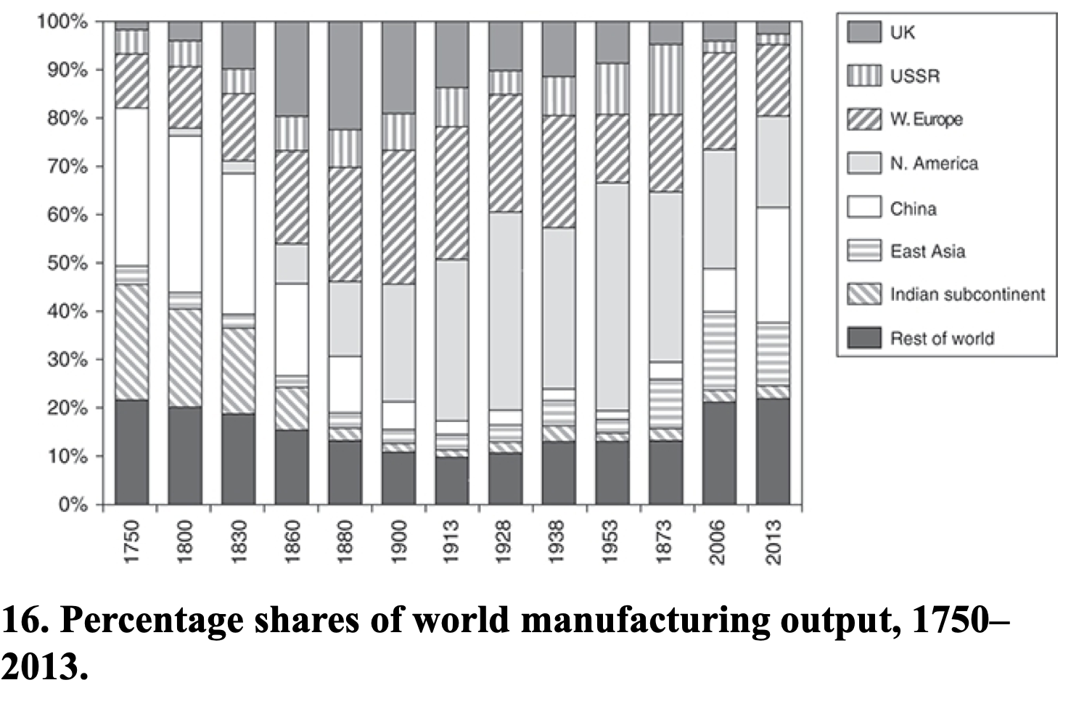
Allen: Spread of Industrialization
Robert Allen (2017): The Industrial Revolution: A Very Short Introduction <https://delong.typepad.com/files/allen-industrial.pdf>, chs. 3, 5-6:
Western Europe: 12% in the 18th century to 28% in 1913
North America: Less than 1% in the 18th century to 47% in 1953
The Pacific Rim share dropped from 4 per cent to 2 per cent in the early 19th century, but then increased to 5 percent in the first half of the 20th century. By 2006, these countries were producing 17 per cent of the world’s manufactures
China in 1953 at 2% of manufacturing was at its all time low. 9 per cent in 2006. 25 per cent in 2013
The Indian subcontinent: 2% of the world’s manufactures in 1973 and only 3% in 2013

Slide 22
Discussion
American Ascendancy
10:35-10:50

Slide 23
Big Ideas: Lecture 13: American Ascendancy
Takeaways from this class:

Slide 24
Catch Our Breath…
Ask a couple of questions?
Make a couple of comments?
Any more readings to recommend?

Slide 25
Notes

Slide 26
Reviews…

Slide 27
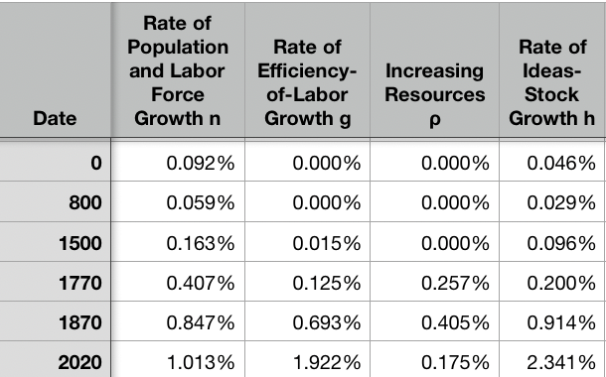
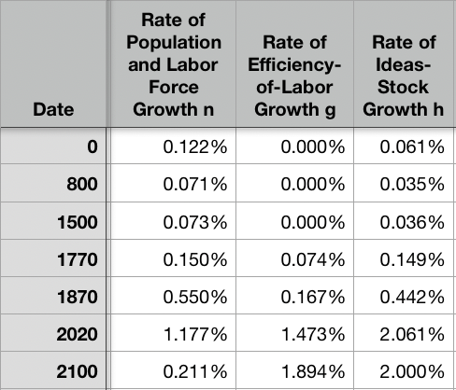
Resources! And Political Economy!
“The Advanced West”
The Columbian Exchange
Corn, the potato, chocolate, &c.: substantial boost to calories
Benefits everywhere!
But one-sided: Europe gains empire and resources wherever its ships can sail and cannon can shoot
Sugar islands and the slave trade
400 calories per Briton per day by 1750?
The underdevelopment of Africa
12.5 million Atlantic African slave trade
(2 million Mediterranean, 4 million Black Sea, 1 million Viking, 17 million Indian Ocean, 30 million Graeco-Roman)
The East Indies
Spices—later silks, porcelain, cottons: 80% fall in real price
Benefits everywhere
But benefits one-sided: disassembling a mountain of silver in Peru in order to import luxuries from China, India, Malaysia, and Indonesia…
Political Economy
The merchants of Bristol, the nabobs, the King of Spain: New wealth to add in to the scales…
Inflation
The World
9:45-10:00

Slide 28
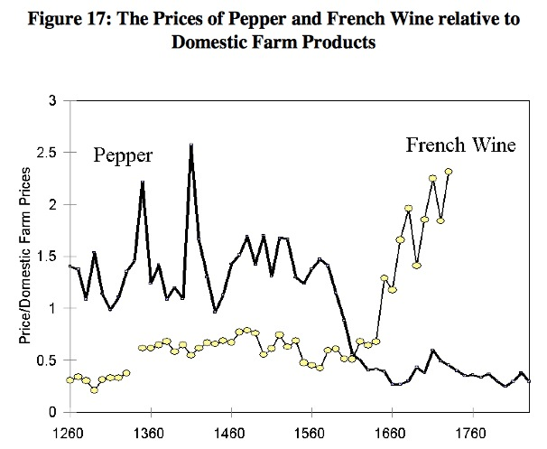
Clark, “The Secret History of the Industrial Revolution”
9:45-10:00

Slide 29
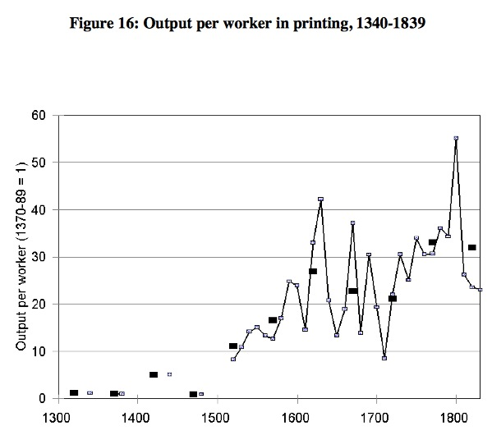
Clark, “The Secret History of the Industrial Revolution”
9:45-10:00

Slide 30
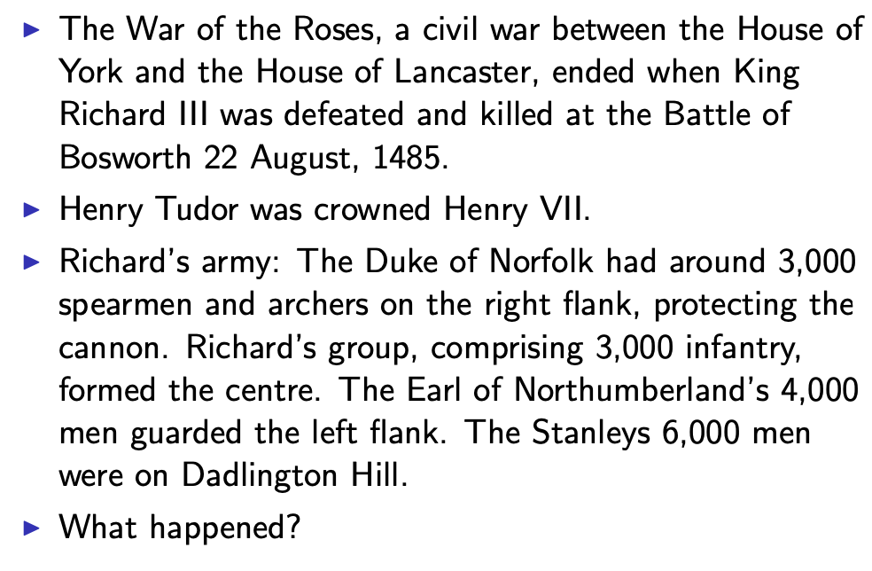
Establishing an Effective Monopoly of Violence: Wars of the Roses
10:10-10:20
Slide taken from Melissa Dell

Slide 31
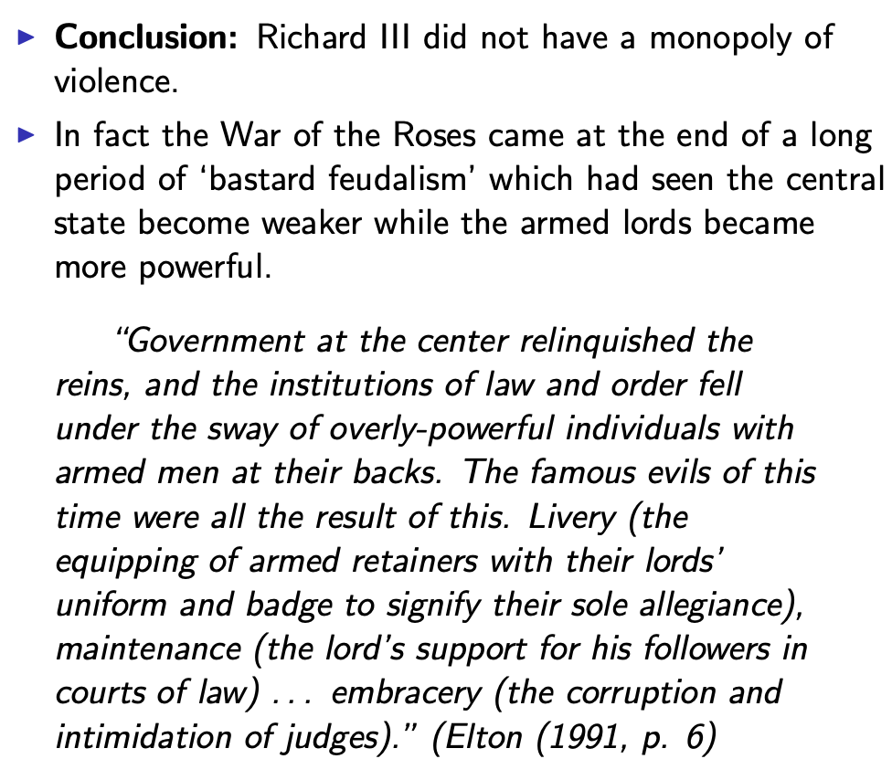
Establishing an Effective Monopoly of Violence: Implications of the Treason of the Stanleys
10:10-10:20
Slide taken from Melissa Dell

Slide 32
Marcher Lords: Warwick the Kingmaker
Adam Smith: “The great Earl of Warwick is said to have entertained every day, at his different manors, 30,000 people; and though the number here may have been exaggerated, it must, however, have been very great to admit of such exaggeration. A hospitality nearly of the same kind was exercised not many years ago in many different parts of the Highlands of Scotland…
10:10-10:20

Slide 33
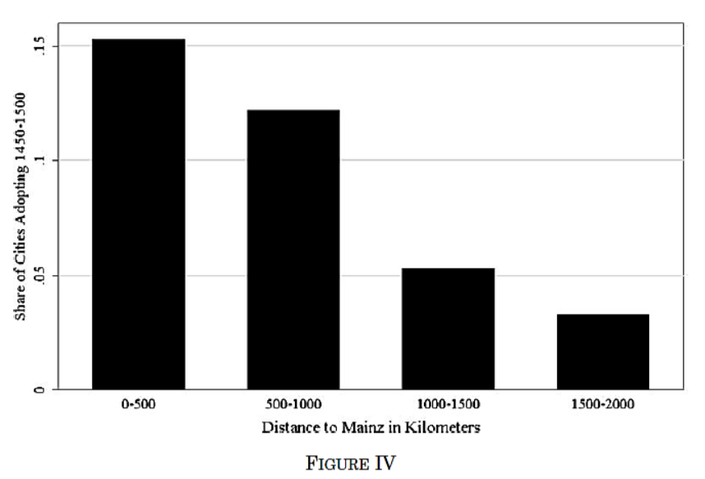
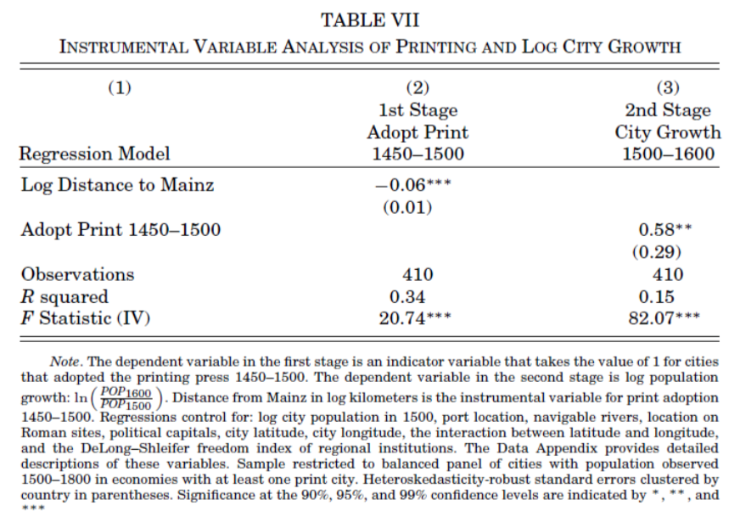
Jeremiah Dittmar (2011): The Printing Press as an Agent of Change… II
Dittmar’s Test: Compare (especially over the period 1500– 1600) population growth of cities that did and did not adopt the printing press before 1500.
Why are DIttmar’s IV estimates so big? 0.6 per century—a near doubling—as opposed to 0.2?
10:10-10:20

Slide 34
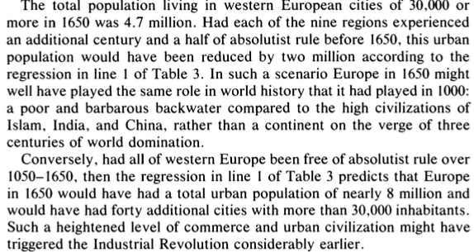
DeLong and Shleifer I
It’s a big deal…
10:10-10:20

Slide 35
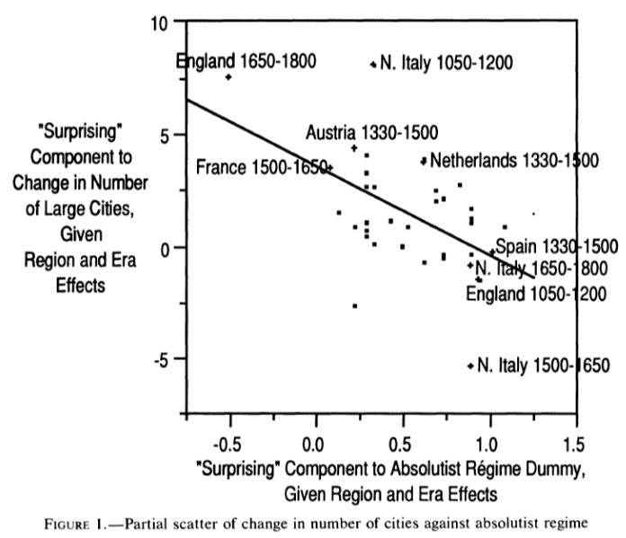
DeLong and Shleifer III
Northern Italy in 1500-1650 is “surprising” as absolutist then
England 1650-1800 is “surprising” as non-absolutist then
WTF?! with the Italian urban boom 1050-1200
Econometric problems
Normal distribution—we have only 45 observations, and 30 degrees of freedom…
The file-drawer problem…
10:10-10:20

Slide 36
Discussion
“Commercial Society” of the Eighteenth Century
An extra 1500 years of invention and innovation, yes…
Scope of control…
Columbian Exchange…
But, otherwise, how different from Antonine Rome or Sung China or Abbasid Mesopotamia?
It did occur in Antonine Rome…
Temin: no industrial revolution…
10:35-10:50

Slide 37
Review: Adam Smith
We Have a Very Keen-Eyed Contemporary Observer:
Read: Christopher Berry (2018): Adam Smith: A Very Short Introduction, chs. 1, 4-6 <https://delong.typepad.com/files/berry-smith.pdf>
The market economy as a game changer
Commercial society:
Hunter, shepherd, agricultural, and commercial stages…
“It is Smith’s explicit reference to a ‘commercial society’ that is distinctive and Smith here is a pioneer…”
Agrarian-Age power lies with the owners of land, and government is ‘a combination of the rich to oppress the poor’
Commercial society sees the growth of the rule of law—and a government that can enforce its property-rights order against local notables, roving bandits, and its own functionaries…
10:15-10:35

Slide 38
Why the Emergence of “Commercial Society”
Friedrich Engels:
“Exceptional periods, however, occur when the warring classes are so nearly equal in forces that the state power, as apparent mediator, acquires for the moment a certain independence in relation to both. This applies to the absolute monarchy of the seventeenth and eighteenth centuries, which balances the nobility and the bourgeoisie against one another; and to the Bonapartism of the First and particularly of the Second French Empire, which played off the proletariat against the bourgeoisie and the bourgeoisie against the proletariat. The latest achievement in this line, in which ruler and ruled look equally comic, is the new German Empire of the Bismarckian nation; here the capitalists and the workers are balanced against one another and both of them fleeced for the benefit of the decayed Prussian cabbage lords…” Origin of the Family…
It was in the kings’ and their bureaucracies’ interests—and they were (sometimes) able to make it stick.
10:15-10:35

Slide 39
Why the Emergence of “Commercial Society” II
Adam Smith, according to Berry:
“The feudal lords were masters… settled disputes, enforced discipline, and commanded their tenants to fight on their behalf….. [But] when foreign commerce introduced… what Smith deliberately calls frivolous and useless goods (he mentions diamond buckles) the lords sold off their land or granted long leases… undermine[d] their power to command and their ability to act as judges because those who had been previously dependent became independent: ‘For the gratification of the most childish, the meanest and the most sordid of all vanities’… these landlords gradually bartered away their whole power and authority (WN 419)…
“Smith calls this change a ‘revolution of the greatest importance to the publick happiness’ (WN 422)
But it was not brought about with the deliberate aim to further the public good…
It was, rather, an example of unintended consequences.
This made possible the ‘regular administration of justice’.
The establishment of that uniformity is crucial
Without it a commercial society is not possible
10:15-10:35

Slide 40
Once You Have the Preconditions for “Commercial Society”…
Commercial Revolution Prosperity:
“Universal opulence which extends itself to the lowest ranks of the people…”
Because of the division of labor…
Possible only in a well-governed society…
Berry: “Through the division of labour ten individuals could make 48,000 pins a day—equivalent to 4,800 each. But if each individual performed all the tasks required (drawing, straightening, cutting, pointing the wire, and so on) then less than twenty would have been manufactured. He gives three reasons for this: increased dexterity that comes from reducing each individual’s task to ‘one simple operation’; time-saving that stems from not having to transfer from one task to the next; and inventing better ways of executing the task prompted by the concentration on one task…”
Division of labor depends on the extent of the market…
And self-interest: “it is not from the benevolence of the butcher, the brewer or the baker that we expect our dinner, but from their regard to their own interest. We address ourselves not to their humanity but to their self- love and never talk to them of our own necessities but of their advantages. Nobody but a beggar chuses to depend chiefly upon the benevolence of his fellow-citizens…”
10:15-10:35

Slide 41

Smith’s “System of Natural Liberty”
Depends on Universal Principles: Smith according to Berry:
A ‘science of human nature’.
The self-interested hope of everyone to better their own condition.
The moral principle that everyone is free.
Individuals are the best judges of their own interests
The outcomes of particular exchanges redound unintentionally to the general benefit.
The ‘miserable poverty’ of the savage nations, as depicted in his Introduction, is left behind
The twin blessings of opulence and freedom are experienced.
10:15-10:35

Slide 42

Review: Why Was Pre-Industrial Progress so Slow on Average?
Our readings:
Willem M. Jongman (2007): Gibbon was Right: The Decline and Fall of the Roman Economy <https://delong.typepad.com/jongman-gibbon-was-right.pdf>
Peter Temin: The Roman Market Economy, Roman Growth <https://delong.typepad.com/files/temin-roman-growth.pdf>
Moses Finley: Technical Innovation and Economic Progress in the Ancient World <https://delong.typepad.com/finley-technical.pdf>
Josh Ober (2019): Agamemnon's Cluelessness, selections <https://delong.typepad.com/files/ober-agamemnon-selections.pdf>

Slide 43
Potential Points of View
What are the possibilities here?:
No puzzle—given how few heads they had, and given the absence of printing and the difficulty of controlled experiments, it is a miracle that they managed to advance technology as far as they did as fast as they did… (Kremer)
No: there was something wrong. They had the wrong kind of society… (Finley, critiqued by Ober)
No: something went wrong: civilization seems to be progressing up to the year 1… 0.013%/yr… 0.030%/yr… 0.061%/yr… & then it stalls out: instead of doubling to a Commercial Revolution rate of growth after the year 1, the rate of ideas growth halves again… (Jongman)

Slide 44
Our Four Readings
What possibilities do they argue for?:
Jongman:
“Population went down… production per man hour must have gone up…. The Roman Empire should have turned into a world of happy and prosperous peasants…. Reality was, of course, different… the emergence of a new social, political, and legal regime, where oppression replaces the entitlements of citizenship…”
Temin:
“The high ratio of wages to energy costs was not only absent in eighteenth-century continental Europe; it was absent as well in the Roman Empire…. There was no possibility of escaping from the Malthusian constraints… no possibility that industrialization could have begun in the ancient world…”
Finley:
“The pejorative judgments of ancient writers about labour, and specifically about the labour of the artisan, and of anyone who works for another, are too continuous, numerous, and unanimous, too wrapped up in discussions of every aspect of ancient life, to be dismissed as empty rhetoric. In other slave-owning societies for whom there is fuller documentation, these implications and their practical effects are unmistakable. Writing about the Great Trek, for example, Sir Keith Hancock said: 'The Boers very soon convinced themselves that artisans' work and slaves' work were the same thing—a conviction which struck such deep roots in their minds that their descendants in the nineteenth century left to British immigrants almost all the opportunities of skilled industrial employment in the expanding towns'. Or Tocqueville, whose I83I notebooks are filled with the theme that 'slavery is even more prejudicial to the masters than to the slaves', because, as a leading Louisville merchant said to him, 'it deprives us of the energy and spirit of enterprise that characterizes the States that have no slaves’…. Comparisons must be made with caution and reserve. But this particular one seems to me to be valid and necessary…”
Ober:
“Greeks were quite capable of the kind of reasoning necessary to build and sustain a growing economy…. Ancient Greeks, as individuals and collectives, frequently employed… rationally instrumental reasoning in economic contexts. It is nonetheless undeniable that there is a body of classical literature that exemplifies the scorn for money-making that was emphasized by the Finley school. Those expressions of scorn underpin the theory of an essentially timeless and changeless ancient economy predicated on violent extraction and gift exchange…. The approach of the Socratic philosophers to economic rationality was fundamentally critical and normative…. For Finley and his school… any activity that was not grounded in status, and in [its] power relations… was… unmoored and ephemeral…. Economic activity aimed at increasing productivity, innovations aimed at increasing efficiency, and increased consumption—rather than securing the status of the relevant actors—were, thereby, rendered more or less invisible—and in any event, unworthy of detailed study. The result was, so I suppose, both a misunderstanding of the relevant texts and a misrepresentation of the underlying social reality…”

Slide 45
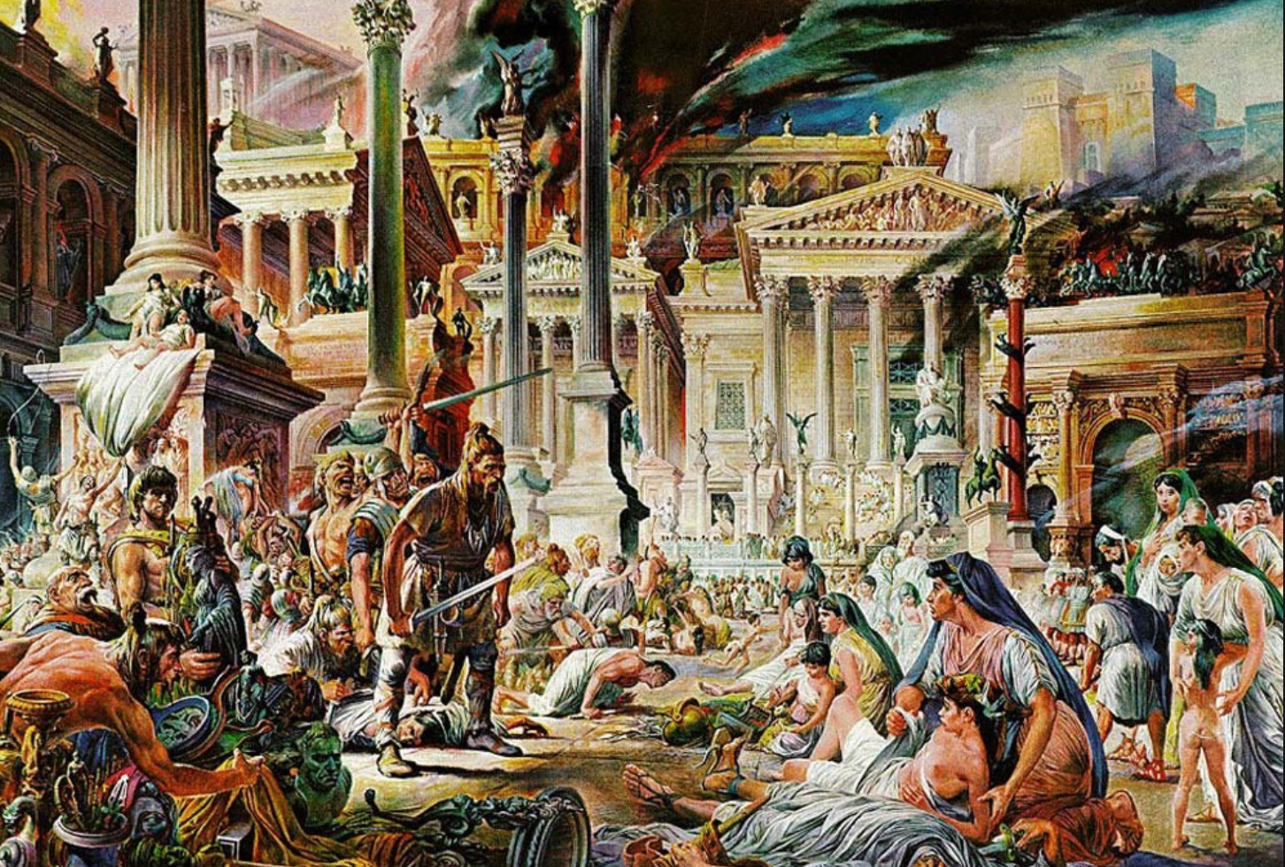


Review: The Fall of Rome
Economic Zenith, Then Economic Decline, Then Political Decline:
While the existing data are somewhat contradictory, the consensus amongst archaeologists is the early 2nd century.
A new social distinction between honestiores (high status) and humiliores (low status with different laws) was introduced.
Citizens began to lose their rights and by the end of the 2nd century, they were being tied to the land as serfs
The Barbarians were at the gates, but it seems reasonable to see this as an outcome of the weakening of Roman institutions
Earlier Rome had defeated far more formidable and better organized enemies like the Carthaginians.
Acemoglu and Robinson argue that the big fact about what preceded the decline is that political institutions moved in a much more extractive direction and this was followed by economic institutions.
Jongman (“Gibbon was Right”) proposes that the Antonine plague which hit the Roman Empire around 160AD is the most likely explanation for the collapse of Rome.
But Malthusian crises are supposed to increase living standards, not reduce them: so what is going on?
Slide taken from Melissa Dell

Slide 46
Three Great Plagues
But the demands of the empire for revenue and of the upper class for resources remain the same:
Antonine Plague (smallpox?): Antonine ⇒ Severian dynasty
Plague of St. Cyrian (Ebola-like?): Things fall completely apart, then Diocletian: between Philip the Arab and Diocletian, 18 emperors in 35 years, plus two breakaways; 12 of the 18 were assassinated
Plague of Justinian (Bubonic): Flavius Apion…

Slide 47
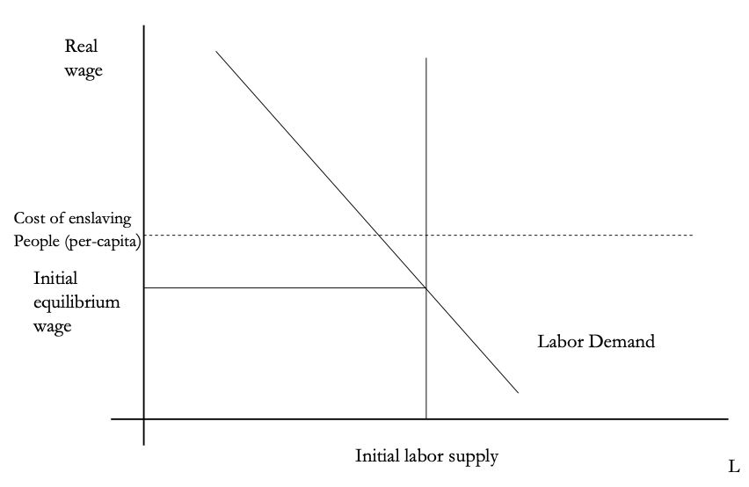
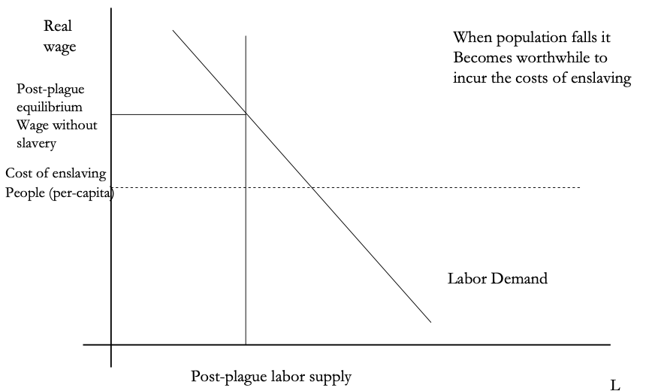
The Domar Hypothesis
You can have a leisured upper class, or abundant land relative to labor, or free labor, but not all three at once:
Slide taken from Melissa Dell

Slide 48
The Later Roman Empire
How does it compare to the expanding Roman Republic?
Militarism: in striking contrast to earlier days, a successful general is a threat to the emperor. Eighteen emperors in 35 years between Philip the Arab and Diocletian
Mobilization: In order to extract resources from a smaller population, the people must be disarmed rather than mobilized.
Distribution: The smaller pool of benefits needs to be hoarded for those with connections, not shared.
Incorporation: You can join the Goths: you cannot join the Roman upper class unless you know someone…

Slide 49
Dell’s Summary of Acemoglu and Robinson on the Rise and Fall of Rome II
For the Roman Empire, the collapse of Roman authority was pronounced, particularly in the West:
By 450AD all the trappings of Roman economic prosperity were gone.
Money vanished from circulation.
Urban areas were abandoned and buildings stripped of stone.
The roads were overgrown with weeds.
The only type of pottery which was fabricated was crude and hand made, not manufactured.
People forgot how to use mortar and they also forgot how to read and write.
Roofs were made of branches, not tiles.
The Eastern Roman Empire lived on, but it contracted significantly with the rise of Islam in the 7th Century.
Slide taken from Melissa Dell

Slide 50
Review: Republic to Empire
Political transition:
The expansion of Rome’s conquests created inequality and increasing political instability.
There were calls for the redistribution of land and power.
For example, Plebeian Tribune Tiberius Gracchus started to develop very ‘populist’ political platforms which threatened the senatorial elites.
The culmination of this was civil war, the dictatorship of Julius Caesar, and finally the creation of the Empire under Augustus.
First the principate
Then the dominate
Augustus reformed the army, removing it as a bastion of plebeian power.
His successor Tiberius stripped the assemblies of powers and gave them to the senate—and then neutered the senate
A semi-hereditary monarchy replaced the Republic:
“May good success attend the Roman senate and people and myself. I hereby adopt as my son Marcus Ulpius Nerva Traianus…”
This was a move towards more “extractive” political institutions and though it stabilized things for awhile, there was an eventual movement towards even more extractive economic institutions
Slide taken from Melissa Dell

Slide 51
Always Scribble, Scribble, Scribble! Eh! Mr. Gibbon?
Beste, Memorials:
The Duke of Gloucester, brother of King George III, permitted Mr. Gibbon to present to him the first volume of The History of the Decline and Fall of the Roman Empire. When the second volume of that work appeared, it was quite in order that it should be presented to His Royal Highness in like manner. The prince received the author with much good nature and affability, saying to him, as he laid the quarto on the table,
“Another damned thick, square book! Always, scribble, scribble, scribble! Eh! Mr. Gibbon?”

Slide 52
Always Scribble, Scribble, Scribble! Eh! Mr. Gibbon?
Five Good Emperors: Nerva-Trajan-Hadrian-Antonius Pius-Marcus Aurelius:
If a man were called to fix the period in the history of the world, during which the condition of the human race was most happy and prosperous, he would, without hesitation, name that which elapsed from the death of Domitian to the accession of Commodus.
The vast extent of the Roman empire was governed by absolute power, under the guidance of virtue and wisdom.
The armies were restrained by the firm but gentle hand of four successive emperors, whose characters and authority commanded involuntary respect.
The forms of the civil administration were carefully preserved by Nerva, Trajan, Hadrian, and the Antonines, who delighted in the image of liberty, and were pleased with considering themselves as the accountable ministers of the laws.
Such princes deserved the honor of restoring the republic, had the Romans of their days been capable of enjoying a rational freedom.
The labors of these monarchs were overpaid by
the immense reward that inseparably waited on their success;
by the honest pride of virtue, and
by the exquisite delight of beholding the general happiness of which they were the authors.

Slide 53
Aelius Aristides
The Roman Oration:
Whatever the seasons make grow and whatever countries and rivers and lakes and arts of Hellenes and non-Hellenes produce are brought from every land and sea, so that if one would look at all these things, he must needs behold them either by visiting the entire civilized world or by coming to this city. For whatever is grown and made among each people cannot fail to be here at all times and in abundance. And here the the merchant vessels come carrying these many products from all region in every season and even at every equinox, so that the city appears a kind of common emporium of the world.
Cargoes from India and, if you will, even from Arabia the Blest one can see in such numbers as to surmise that in those lands the trees will have been stripped bare and that the inhabitants of these lands, if they need anything, must come here and beg for a share of their own. Again one can see Babylonian garments and ornaments from the barbarian country beyond arriving in greater quantity and with more ease than if shippers from Naxos or from Cythnos, bearing something from those islands, had but to enter the port of Athens. Your farms are Egypt, Sicily and the civilized part of Africa.
Arrivals and departures by sea never cease, so that the wonder is not that the harbor has insufficient space for merchant vessels, but that even the sea has enough, if it really does.
And just as Hesiod said about the ends of the Ocean, that there is a common channel where all waters have one source and destination, so there is a common channel to Rome and all meet here, trade, shipping, agriculture, metallurgy, all the arts and crafts that are or ever have been, all the things that are engendered or or grow from the earth. And whatever one does not see here neither did nor does exist. And so it is not easy to which is greater, the superiority of this city in respect to the cities that now are or the superiority of this city respect to the empires that ever were…

Slide 54
Review: The Rise of Rome
Roman Institutions are key to the rise of Rome:
In 510BC, the citizens of Rome overthrew their king, Lucius Tarquinius Superbus, and created a republic.
The state was run by elected officials:
Two consuls who had the job for one year
Other magistrates: praetors, aediles, proconsuls
Tribunes.
Offices were elected, annual, and held by multiple people at the same time
This greatly reduced the ability of any one person to consolidate or exploit his power.
The institutions of the Republic contained a system of checks and balances which distributed power fairly widely.
Even if elite patrician families had far more power, it was possible for non-elites, so called plebeians, to get to the top, and they constrained the power of the elites.
Then some plebeian families become equally elite…
The nobiles
Roman assemblies:
Centuriate: 193 centuries on the basis of military organization, weighted toward the rich. Elects the magistrates, declares war and peace
Tribal: After 241 BC, 35 tribes on the basis of geographical location
Plebeian: Non-patricians, run by Tribunes
Senate
Roman institutions:
Legions
Phalanx
Manipular
Marian
Imperium
Provinciae
Proconsuls and propraetors
Slide taken from Melissa Dell

Slide 55
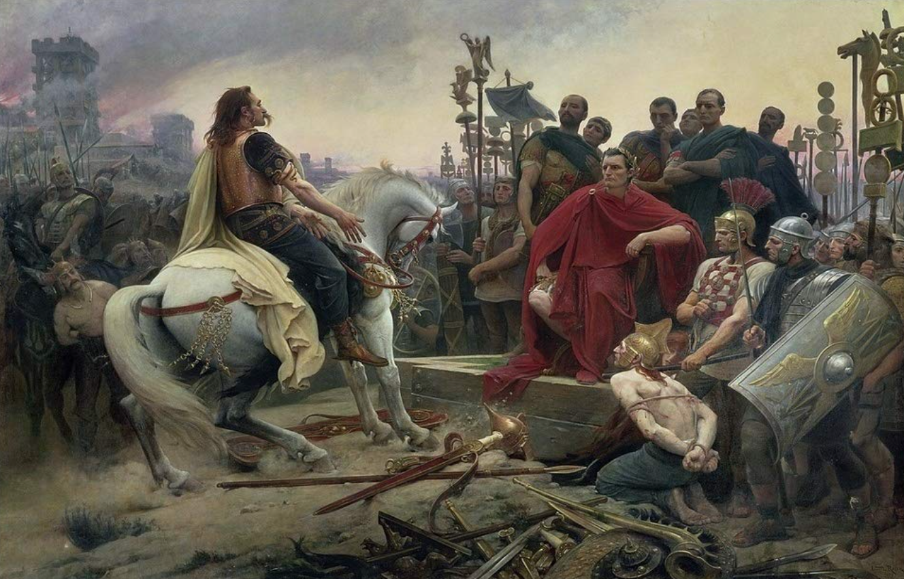
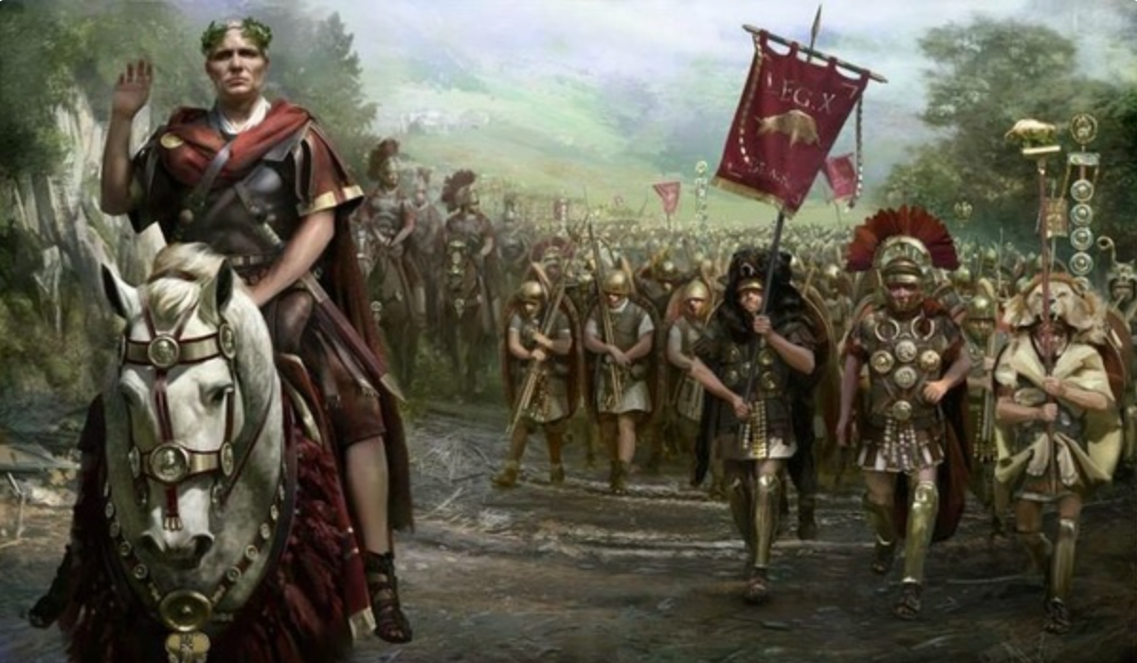
The Rise of Rome II
Roman Institutions are key to the rise of Rome:
Four key factors:
Militarism (on the part of elites competing for authority)
Mobilization (of the citizen mass)
Widely shared benefits (of conquest)
Incorporation (of conquered communities)
Mammoth military and political expansion after -340, and substantial economic, expansion
Slide taken from Melissa Dell

Slide 56
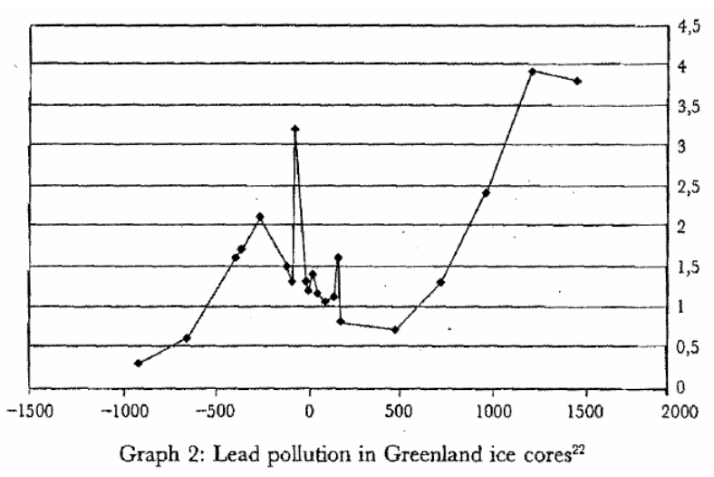
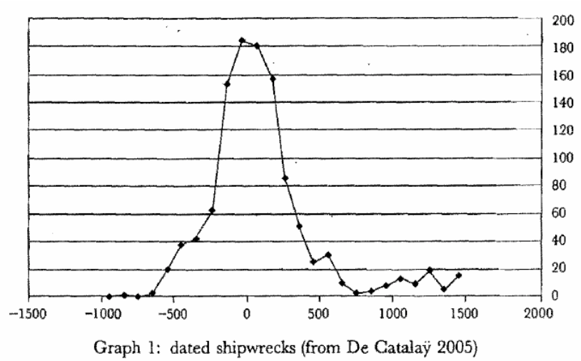
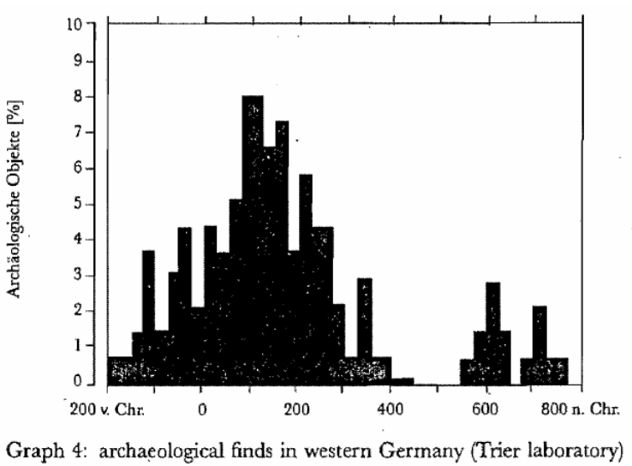
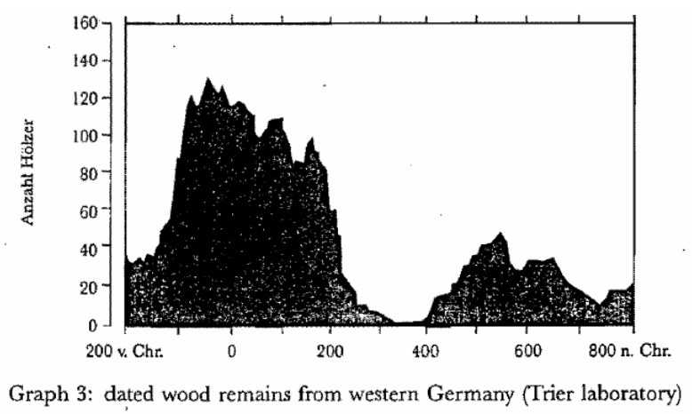

Measuring Roman Efflorescence
There are many interesting ways to track economic expansion:
Shipwrecks indicate trade, but they also track the movement of goods by fiat. For example, the citizens of Rome were kept happy by the free distribution of bread after 58BC. This was later extended to olive oil and even wine. This had to be shipped (mostly from Egypt and North Africa).
The Romans also moved around taxes levied in the provinces and supplied their troops. Some argue that 2/3 of all the ‘trade’ was actually the state moving stuff around.
For Roman citizens, economic institutions were quite good. However, the Italian economy was based on slavery (about 35% of the population of Italy were slaves at the time of the Emperor Augustus). There was little technological change.
Slide taken from Melissa Dell

Slide 57
Review: Pre-Industrial “Efflorescences”
Ideas courtesy of Jack Goldsmith, Daron Acemoglu and James Robinson:
The Malthusian model misses a great deal of the interesting action prior to the Industrial Revolution.
An alternative explanation for why there was no long-run trend in living standards is the theory of ‘efflorescence and decline’
I organize my thoughts about this with the two Malthusian equations, and with their bunch of variables and parameters: h, γ, β, φ, y^{sub}, s, δ, θ, and H that together determine y^{*mal} and L^{*mal}
This is best thought of as a filing system for factors that may be important—given the importance of both capital and labor efficiency, the roles of ideas and of resources in producing labor efficiency, and Malthusian population dynamics, these are the things you should look at

Slide 58
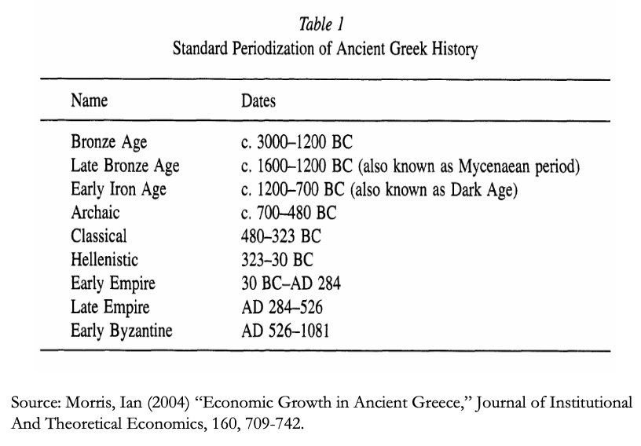
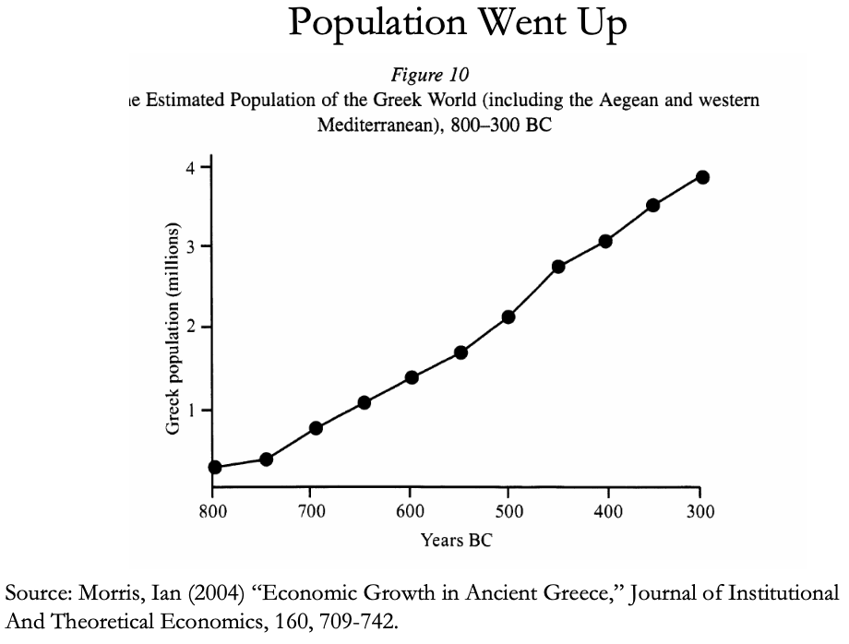
The Classical Greek Efflorescence
Emerging out of the Iron Dark Age of -1200 to -800:
When the Greek city states emerged they did so with functional systems of governance which provided public goods, such as security for trade and investment.
This initiated a period of sustained increases in living standards.
While Ancient Greece did have a period of democracy, it was relative short (less than 200 years) compared to the duration of the polity and most citizens - slaves, poor citizens who couldn’t afford their tax bill, women - could not participate.
Greek institutions (rules according to which the society was organized) tended to be “extractive.” For example, the economy was largely based upon slavery.
Slide taken from Melissa Dell

Slide 59
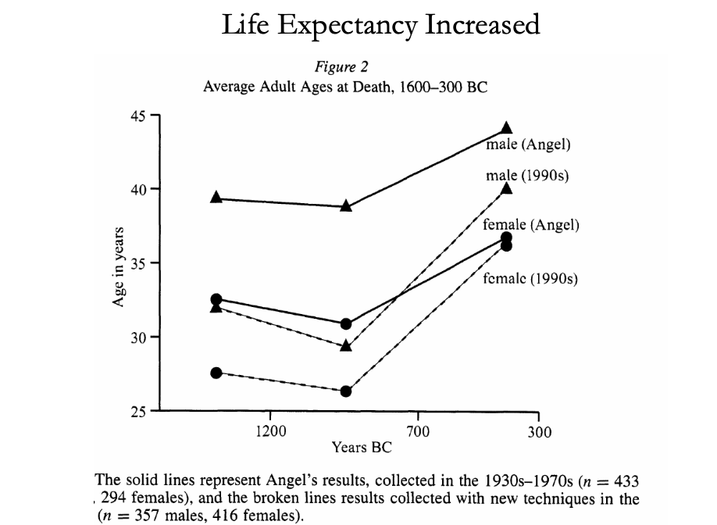
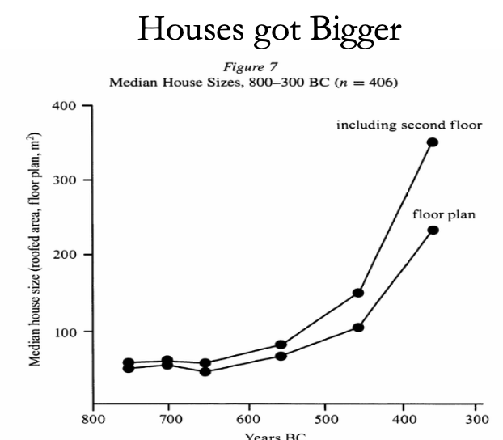
The Classical Greek Efflorescence II
“Developmental” or “Extractive”?
Extractive political institutions concentrate political power in the hands of some group who can use that power to redistribute wealth and income to themselves. This resulting concentration of wealth tends to reinforce the initial set of political institutions.
Roving bandits or stationary bandits?
Acemoglu and Robinson hypothesize that growth was not sustained in ancient societies because their institutions were extractive, and extractive institutions are incompatible with sustaining growth in the long run.
They argue that this is because extracting resources creates conflicts over who will control those resources, and it may also induce rebellion from below.
In either case political instability can bring the government and economy down.
Slide taken from Melissa Dell

Slide 60
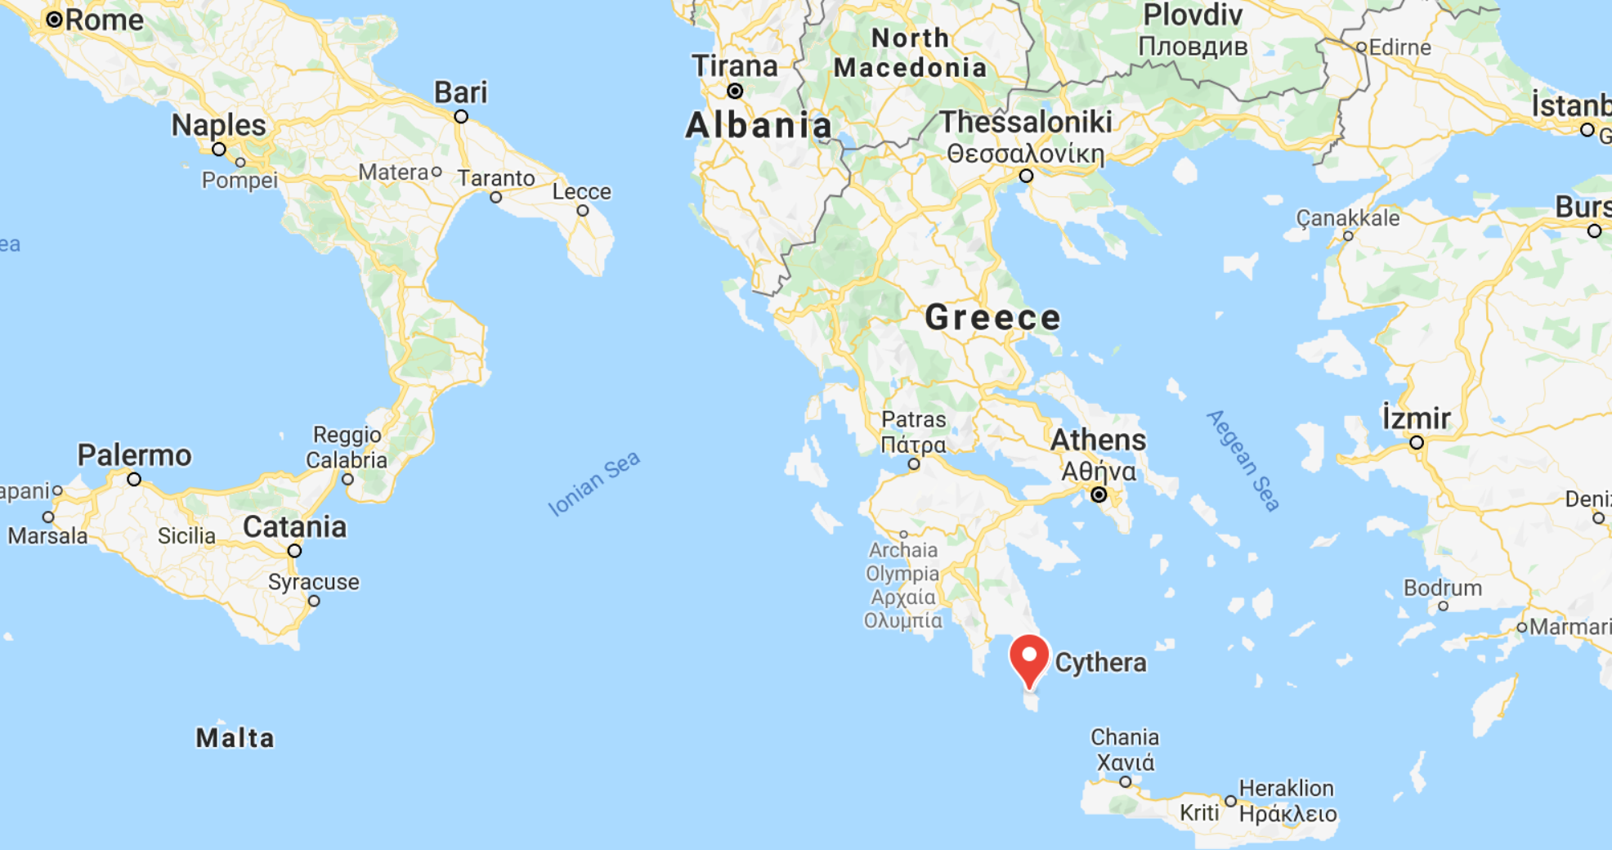
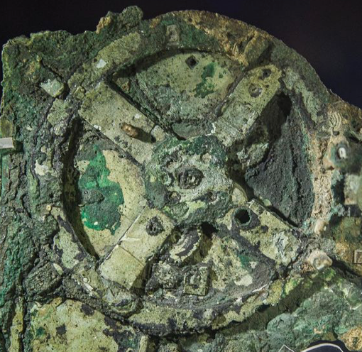
The Anti-Kythera Mechanism
What is this?
Built between -150 and -70. Rhodes13” x 7” x 4“ wooden box
Gears—largest 5” in diameter
Inscriptions
Wikipedia: “37 gear wheels enabling it to follow the movements of the Moon and the Sun through the zodiac, to predict eclipses and even to model the irregular orbit of the Moon, where the Moon's velocity is higher in its perigee than in its apogee. This motion was studied in the 2nd century BC by astronomer Hipparchus of Rhodes, and it is speculated that he may have been consulted in the machine's construction. The knowledge of this technology was lost at some point in antiquity. Similar technological works later appeared in the medieval Byzantine and Islamic worlds, but works with similar complexity did not appear again until the development of mechanical astronomical clocks in Europe in the fourteenth century…”

Slide 61
The Anti-Kythera Mechanism II
What is this?
Brian Resnick: “A main gear would move to represent the calendar year, and would, in turn, move many separate smaller gears to represent the motions of the planets, sun, and moon. So you could set the main gear to the calendar date and get approximations for where those celestial objects would be in the sky on that date…. You, as a user, could input a few simple variables and it would yield a flurry of complicated mathematical calculations.… All the user had to do was enter the main date on one gear, and through a series of subsequent gear turns, the mechanism could calculate things like the angle of the sun crossing the sky. (For some reference, mechanical calculators—which used gear ratios to add and subtract—didn’t arrive in Europe until the 1600s)…”

Slide 62
Cicero (-54): De Re Publica
“With the exception of the dream of Scipio, in the last book, the whole treatise was lost till the year 1822, when the librarian of the Vatican discovered a portion of them among the palimpsests in that library. What he discovered is translated here; but it is in a most imperfect and mutilated state. The form selected was that of a dialogue, in imitation of those of Plato…”
I.XIV:
Then Philus said: “I am not about to bring you anything new, or anything which has been thought over or discovered by me myself. But I recollect that Caius Sulpicius Gallus, who was a man of profound learning, as you are aware, when this same thing was reported to have taken place in his time, while he was staying in the house of Marcus Marcellus, who had been his colleague in the consulship, asked to see a celestial globe which Marcellus’s grandfather had saved after the capture of Syracuse from that magnificent and opulent city, without bringing to his own home any other memorial out of so great a booty; which I had often heard mentioned on account of the great fame of Archimedes; but its appearance, however, did not seem to me particularly striking. For that other is more elegant in form, and more generally known, which was made by the same Archimedes, and deposited by the same Marcellus in the Temple of Virtue at Rome.
“But as soon as Gallus had begun to explain, in a most scientific manner, the principle of this machine, I felt that the Sicilian geometrician must have possessed a genius superior to anything we usually conceive to belong to our nature. For Gallus assured us that that other solid and compact globe was a very ancient invention, and that the first model had been originally made by Thales of Miletus. That afterward Eudoxus of Cnidus, a disciple of Plato, had traced on its surface the stars that appear in the sky, and that many years subsequently, borrowing from Eudoxus this beautiful design and representation, Aratus had illustrated it in his verses, not by any science of astronomy, but by the ornament of poetic description. He added that the figure of the globe, which displayed the motions of the sun and moon, and the five planets, or wandering stars, could not be represented by the primitive solid globe; and that in this the invention of Archimedes was admirable, because he had calculated how a single revolution should maintain unequal and diversified progressions in dissimilar motions.
“In fact, when Gallus moved this globe, we observed that the moon succeeded the sun by as many turns of the wheel in the machine as days in the heavens. From whence it resulted that the progress of the sun was marked as in the heavens, and that the moon touched the point where she is obscured by the earth’s shadow at the instant the sun appears opposite….
Scipio: “I had myself a great affection for this Gallus, and I know that he was very much beloved and esteemed by my father Paulus. I recollect that when I was very young, when my father, as consul, commanded in Macedonia, and we were in the camp, our army was seized with a pious terror, because suddenly, in a clear night, the bright and full moon became eclipsed. And Gallus, who was then our lieutenant, the year before that in which he was elected consul, hesitated not, next morning, to state in the camp that it was no prodigy, and that the phenomenon which had then appeared would always appear at certain periods, when the sun was so placed that he could not affect the moon with his light…”

Slide 63
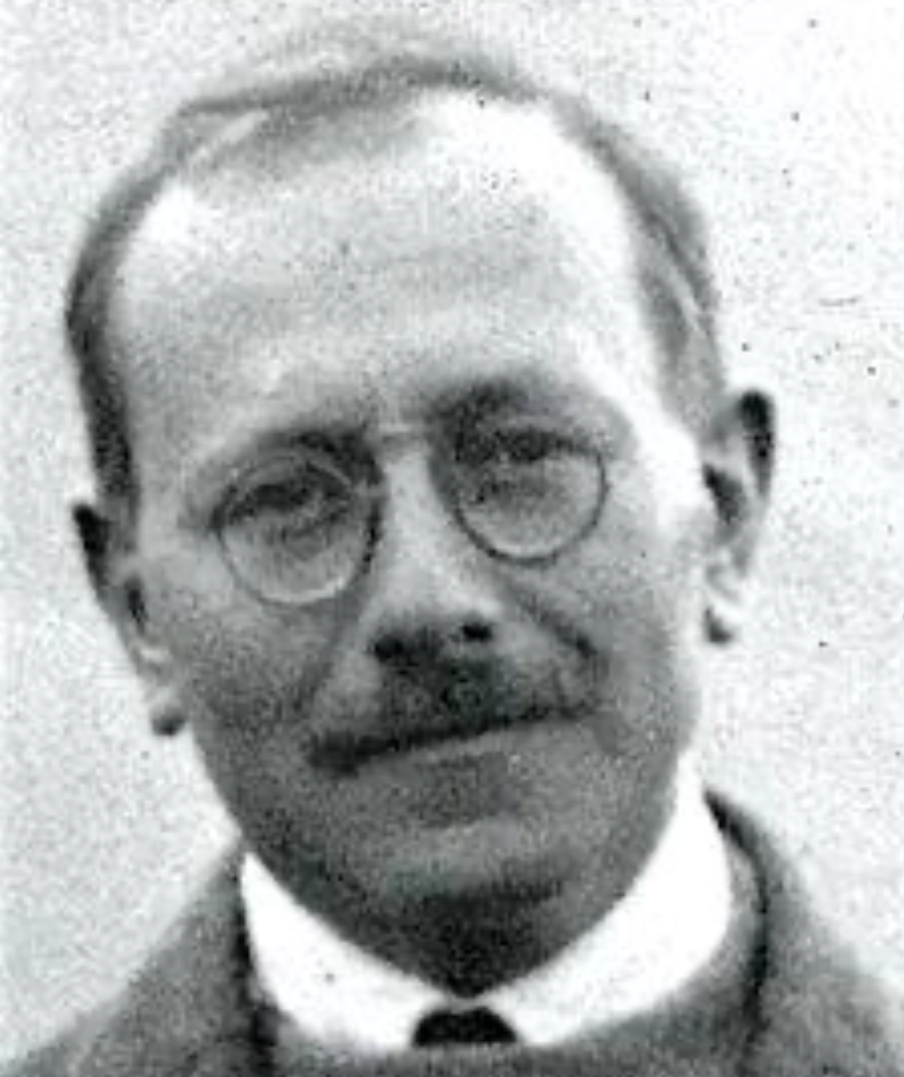
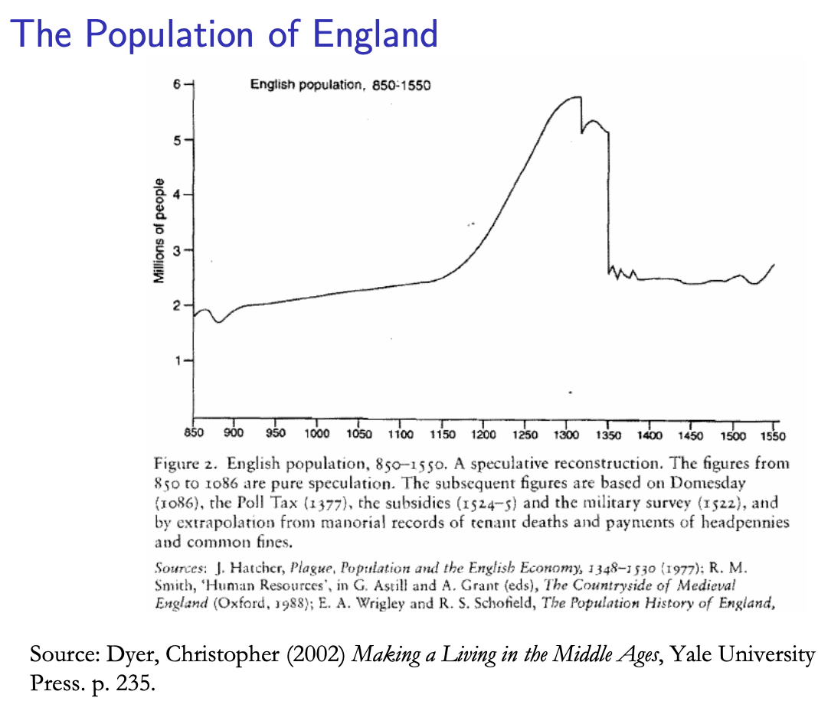
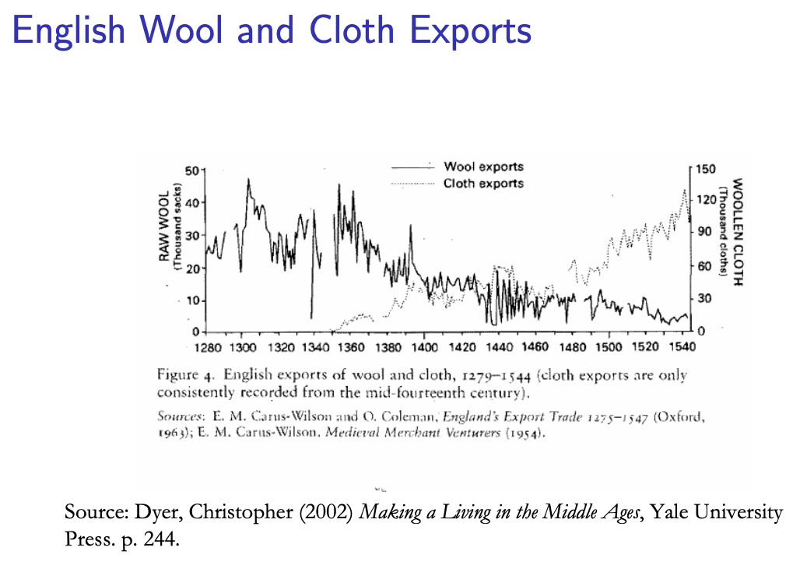
Review: Class and Conflict: at the End of the Middle Ages, Elsewhere, and Elsewhere
What was “feudalism” and how did it end?
Marc Bloch’s definitions:
A subject peasantry
Widespread use of the service tenement (i.e., the fief) instead of a salary (or of private property plus taxation and then purchase)
The supremacy of a caste of specialized warriors
Ties of obedience and protection which bind man to man
Within the warrior class, these ties assume the distinctive form called vassalage
Fragmentation of authority
Disorder and private war
But also, other forms of association, family, and state surviving…
By the late Middle Ages feudalism was a stable system
Trade and population expanded
What data we have shows the number and size of cities increasing
Slide taken from Melissa Dell

Slide 64
A Four-Cornered Fight
Kings, Lords, Commons, & Peasants:
Class alliances, class power, and class conflict…
Plus ideological legitimations…
Friedrich Engels: “Exceptional periods, however, occur when the warring classes are so nearly equal in forces that the state power, as apparent mediator, acquires for the moment a certain independence in relation to both. This applies to the absolute monarchy of the seventeenth and eighteenth centuries, which balances the nobility and the bourgeoisie against one another; and to the Bonapartism of the First and particularly of the Second French Empire, which played off the proletariat against the bourgeoisie and the bourgeoisie against the proletariat. The latest achievement in this line, in which ruler and ruled look equally comic, is the new German Empire of the Bismarckian nation; here the capitalists and the workers are balanced against one another and both of them fleeced for the benefit of the decayed Prussian cabbage Junker-squires…”
This is not just in exceptional periods…
The relative autonomy of the state is the rule, not the exception…

Slide 65
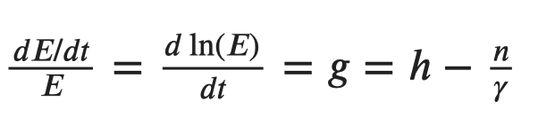
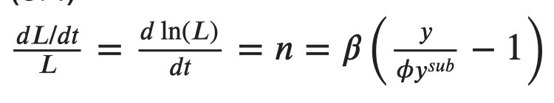
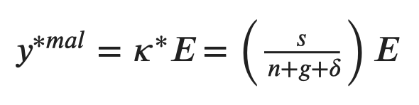
Review: Malthusian Models and Reality

Slide 66
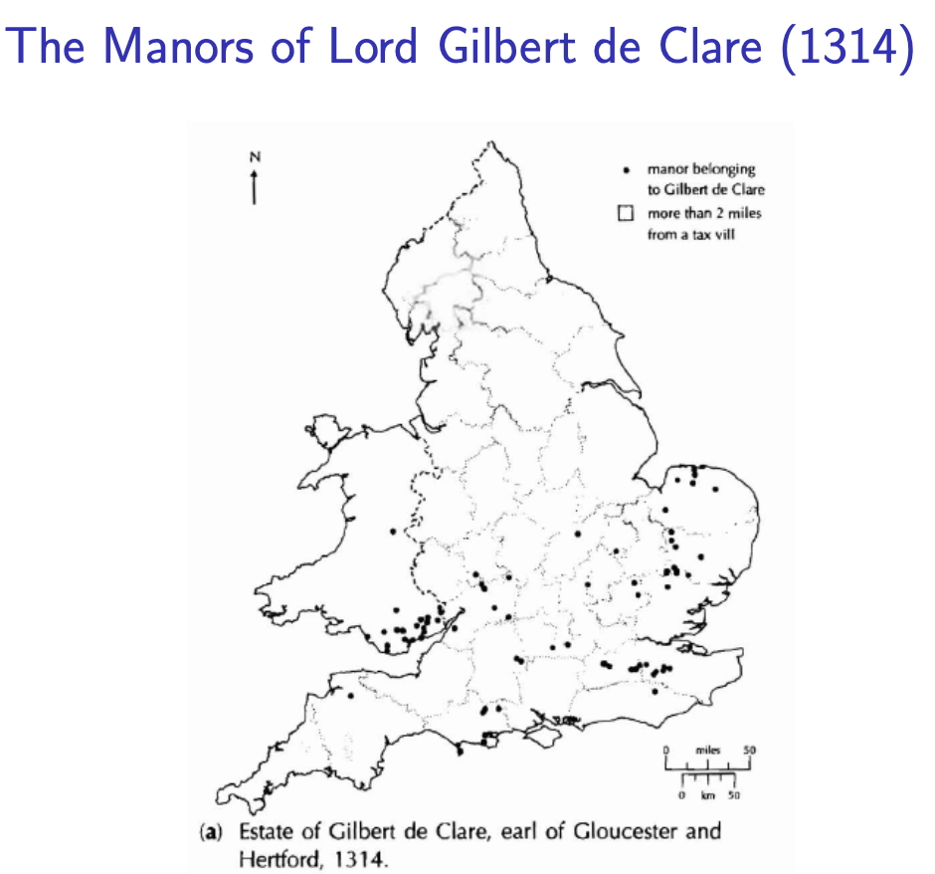
Eastern Europe and the “Second Serfdom”
The percentage of people killed in Europe was similar across space:
After the plague, landlords in Eastern Europe started to take over large tracts of land and expand their holdings, which were already larger than those in Western Europe.
Towns were weaker and less populous and rather than becoming freer, workers began to see their already existing freedoms encroached on: the Domar hypothesis at work.
This contrasts with western Europe.
Effects became especially pronounced after 1500, when Western Europe began to demand the agricultural goods which the East produced.
Eastern landlords ratcheted up their control over the labor force to expand their production.
Mecklenberg: in 1500, peasants owed only a few days service a year; by 1600 this was three days/week; children had to work for the lord for free for several years.
In Hungary, landlords legislated one day a week of unpaid labor services for each worker. In 1550 this was raised to 2 days per week. By the end of the century it was 3 days. Serfs subject to these rules made up 90% of the rural population.
What was it that allowed the Spanish settlers in Mexico to keep wages so low, when in England after the Black Death the state had been incapable of enforcing the Statue of Laborers and stopping wages from rising?
William the Conqueror rewarded his army by providing them with parceled landholdings to prevent them from becoming powerful regional warlords (save for the “marcher lords” along the Scottish and Welsh borders).
Many landholders in close proximity created intense competitive pressures for labor in the wake of the Black Death.
Slide taken from Melissa Dell

Slide 67
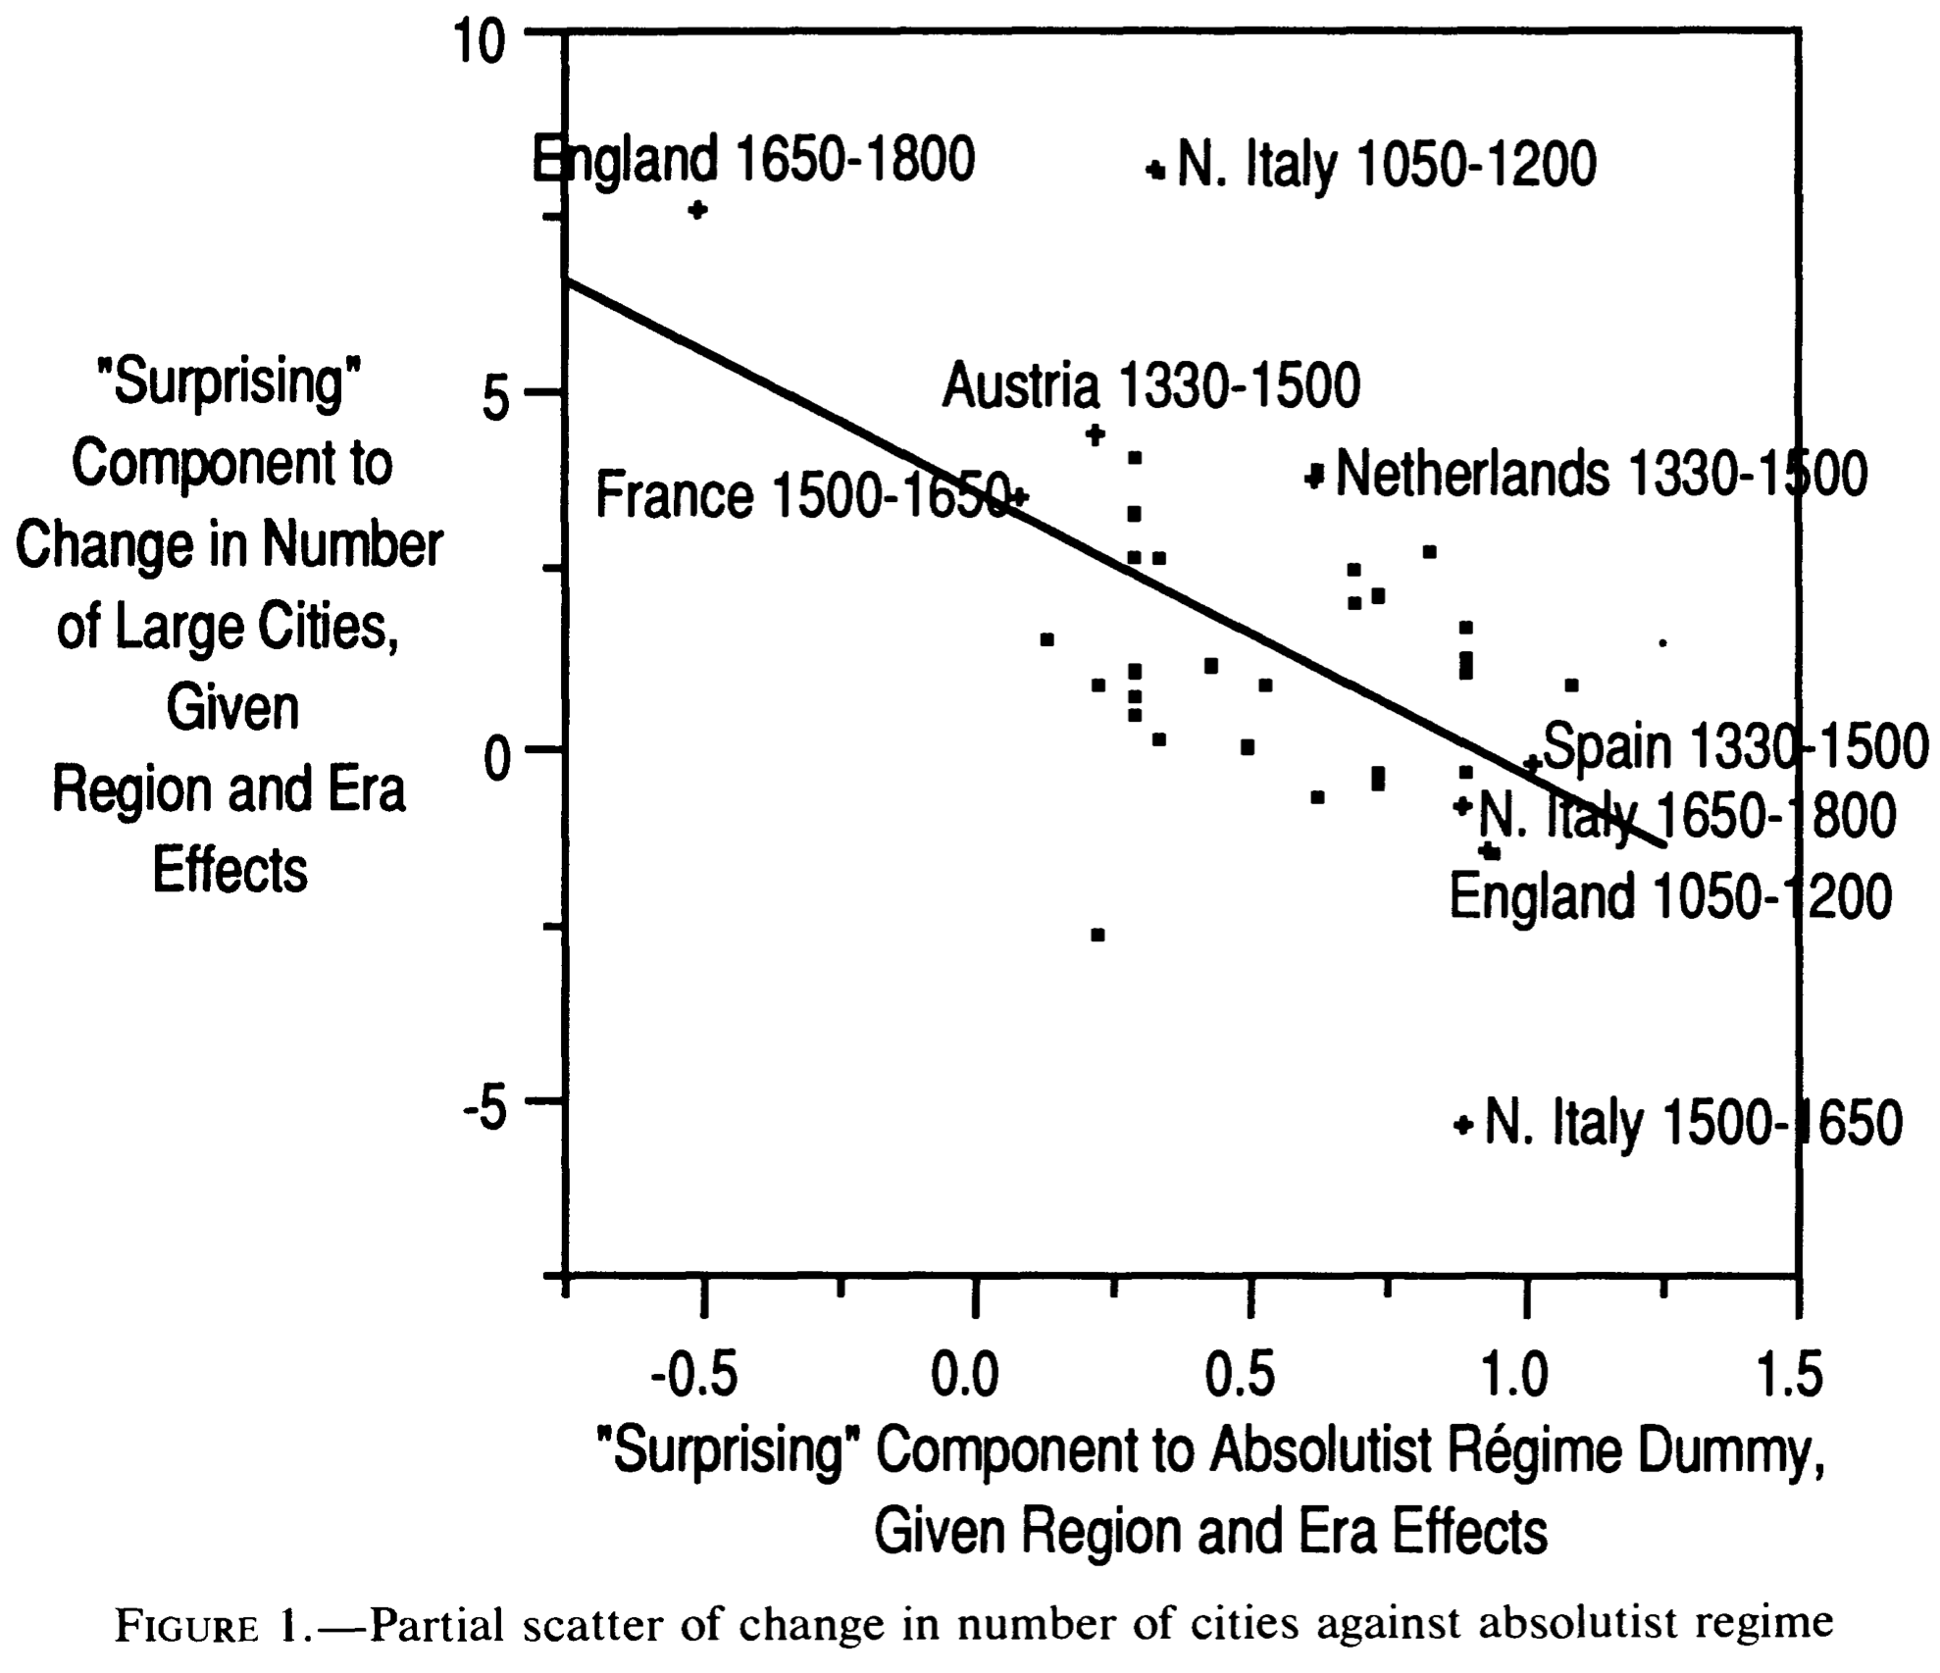
Is Malthus Right? II
At the macro level, yes; but there are lots of interesting meso- and small-scale puzzles:
In addition, measures of good government, such as proxies for constraints on the executive, are correlated with urbanization in this period.
For example, DeLong and Shleifer (1993) showed there was a strong correlation between form of government and urbanization in the pre-modern world
Charles Wilson (1967): Trade, Society, and the State: "The two areas which in 1500 represented the richest and most advanced concentrations of trade, industry and wealth were the quadrilateral formed by the Italian cities Milan, Venice, Florence and Genoa; and the strip of the Netherlands that ran from Ypres north-east past Ghent and Bruges up to Antwerp. It was not merely coincidence that these were the areas where the tradesmen of the cities had been most successful in emancipating themselves from feudal interference and in keeping at bay the newer threat of more centralized political control offered by the new monarchies. In the fleeting intervals between the storms of politics and war, men here glimpsed the material advance that was possible when tradesmen were left in peace unflattered by the attentions of strategists who regarded their activities as the sinews of war…”
Slide taken from Melissa Dell

Slide 68
Malthus: Summing Up
On the broadest scale only:
The simple Malthusian model may indeed capture some realities.
If labor markets are competitive, population growth may indeed induce a decline in wages.
Or if there is a fixed amount of land and few opportunities for labor intensive cultivation systems, a population increase may lead to a decline in output per worker.
However, the reality is typically much more messy.
How wages respond to changes in income will depend on institutions.
Thus the overwhelming likelihood that institutional or cultural factors also shaped pre-modern growth
It was not simply being dictated by the Malthusian relationship between births, deaths, and income.
Slide taken from Melissa Dell

Slide 69
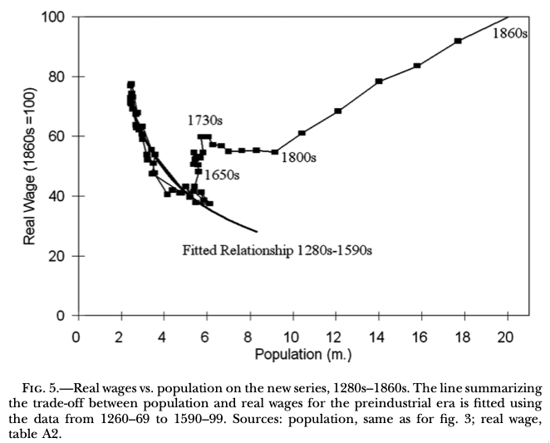
Review: “Subsistence”

Slide 70
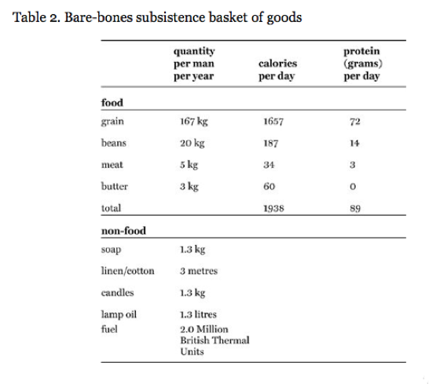
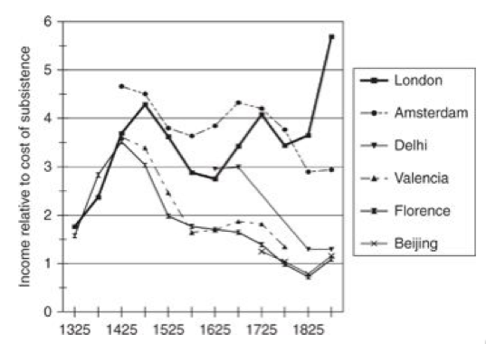
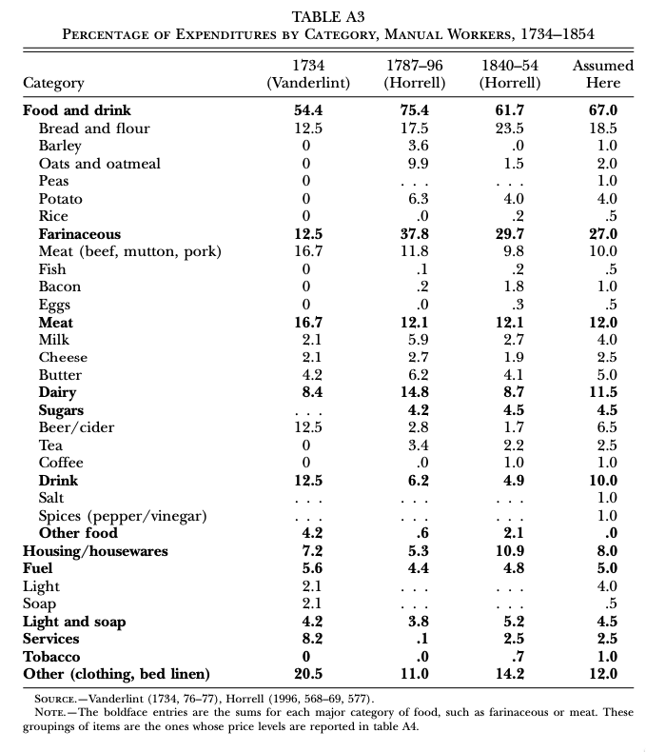
“Bare-Bones”
From Clark & Allen:
"Manual workers”—70% of median, 50% of average income
In 1800: the English population in 1800 is a very rich pre-industrial population
70% of spending spent on food
30-40% grains
20% meat and dairy
“Bare-bones” subsistence
Cities: Malthus rules, but it takes centuries—and other things can and do happen

Slide 71
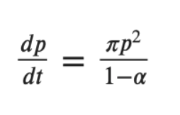
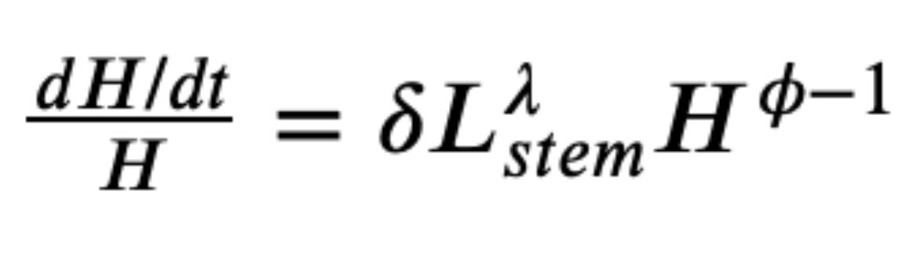
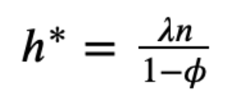
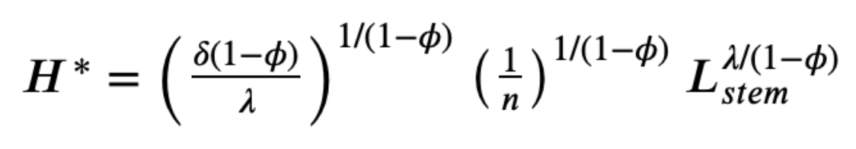
Review: Determinants of Technological and Organizational Progress
How do we make sense of the fact that technological and organizational progress was so slow back then and is so (relatively) rapid now?
Two heads are (almost) better than one
But that does not quite work
Add in additional drag from first picking low-hanging fruit
What causes the increase in Lstem?
What institutions make it profitable for nstem to be higher?
Plus:
Learning by doing
Productivity through embodiment
Technology transfer through contact

Slide 72
Review: Solow-Malthus Model Basics
How do we make sense of the fact that people were ingenious and inventive back before 1500, and yet standards of living did not increase?
Although population did increase—slowly
Other parts of the model
Balanced-growth equilibrium
Convergence to equilibrium
Lecture notes: <https://nbviewer.jupyter.org/github/braddelong/long-form-drafts/blob/master/solow-model-5-pre-industrial.ipynb>
datahub: <http://datahub.berkeley.edu/user-redirect/interact?account=braddelong&repo=long-form-drafts&branch=master&path=solow-model-5-pre-industrial.ipynb>

Slide 73
Understanding the Solow-Malthus Equilibrium: Population and Labor Force
Notes:

Slide 74
Understanding the Solow-Mathus Equilibrium: Prosperity
Notes:

Slide 75

Steady-State and Along the Transition Path
The fall of an empire:
<https://nbviewer.jupyter.org/github/braddelong/LS2019/blob/master/2019-10-14-Ancient_Economies.ipynb>
A decline in inequality, taste for luxuries, and taste for urban living: Δφ = -0.25
A decline in law-and-order that produces a sharp fall in the savings rate: Δs = -0.10

Slide 76






Review: Solow Model Basics
Lecture Notes: <https://www.bradford-delong.com/2020/01/lecture-notes-the-solow-growth-model-the-history-of-economic-growth-econ-135.html>

Slide 77

Solving the Model

Slide 78

Along the Balanced-Growth Path
Everything except κ—which is constant—grows at a constant proportional rate: either n, or g, or n+g;
Labor force L grows at n
Income per worker y and the efficiency of labor E grow at g
Total income Y and the capital stock K grow at n+g

Slide 79
Review: Long-Run Patterns: Global h, g, & n

Slide 80

Long-Run Patterns: “Western” h, g & n
Where does the “ρ” come from?
“Ghost acreage”—conquest and resource utilization (sugar islands, timberlands, cottonlands, etc.)
Cultural expansion—Australia, Canada, New Zealand, & U.S.; Spain & Italy & Scandinavia; plus Japan, Korea, Taiwan, Hong Kong, & Singapore

Slide 81

One Figure: A Great Divergence
10:20
From 1800 to 2018:
The dots start with a 3-1 spread in incomes and a 10-year spread in life expectancy.
All the arrows go up.
Some arrows—mostly those already to the right—go right fast.
Other arrows go right slowly.

Slide 82

China and India and America, 1800-1975
From 1800 to 1975:
Measured living standards and productivity levels improve fourteen-fold in the United States…
…& less than 30% in China & India…
…in spite of economic, transport, and cultural globalization…
This is crazy!
A “great divergence”
Not only were China & India relatively poor in 1800, they fell further behind thereafter

Slide 83

China and India and America, 1975–2018
From 1975-2018:
Measured living standards and productivity levels…
…54.9/25.9 = 2.12 in America…
…16.0/0.9 = 17.8 in China…
…6.9/1.2 = 5.8 in India…

Slide 84
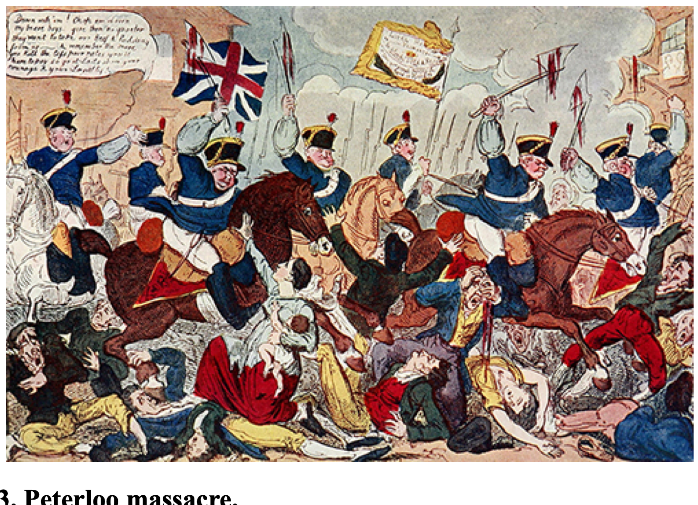
Review: Allen: Reform and Democracy
Robert Allen (2017): The Industrial Revolution: A Very Short Introduction <https://delong.typepad.com/files/allen-industrial.pdf>, chs. 3, 5-6:
Enlightenment, literacy, pamphlets, The Rights of Man (sells 1 million copies), & the French Revolution
60,000-strong Manchester demonstration in 1819: eleven killed: “Peterloo”
“Reform that we may preserve”: 1832 Reform Bill
Virtual representation
Divide the reformers
1833: Factory Act—9-hour day for children under 12
1834: New Poor Law—workhouses

Slide 85
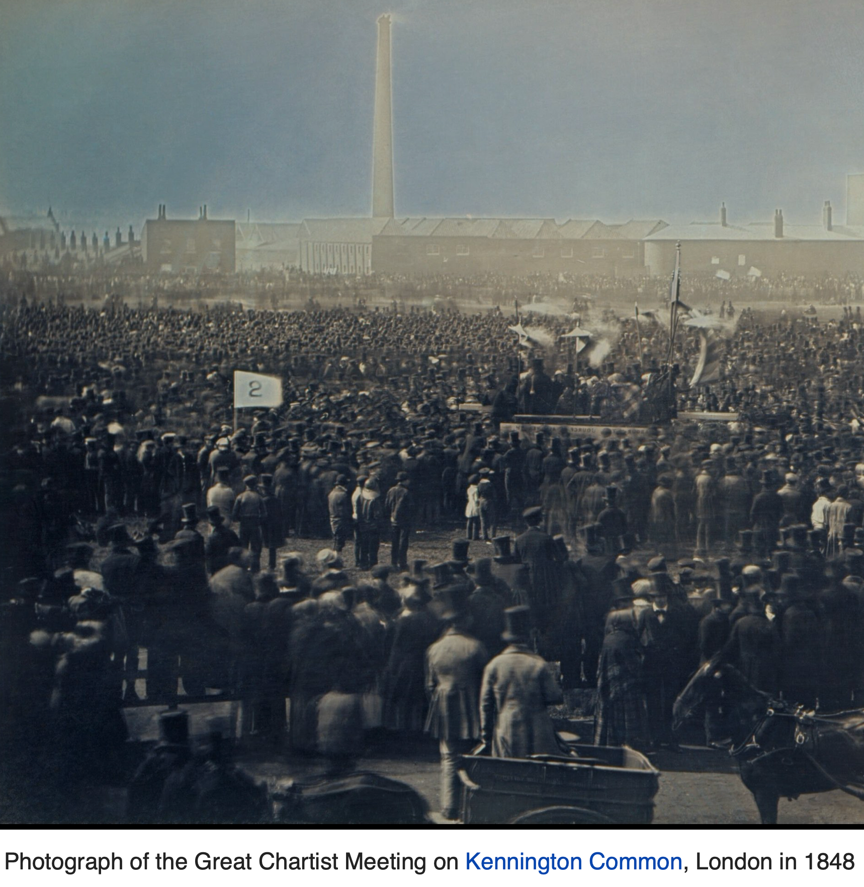
Allen: Reform and Democracy II
Robert Allen (2017): The Industrial Revolution: A Very Short Introduction <https://delong.typepad.com/files/allen-industrial.pdf>, chs. 3, 5-6:
1833: Factory Act—9-hour day for children under 12
1834: New Poor Law—workhouses
1838: People’s Charter
1846: Corn Law Repeal
The “condition of England”
John Stuart Mill (1848 and 1871): “It is questionable if all the mechanical inventions yet made have lightened the day's toil of any human being. They have enabled a greater population to live the same life of drudgery and imprisonment…”
1846-67: Real wage stagnation ends: average consumption per head in working class families rose by 42 per cent…

Slide 86
The People’s Charter
The People's Charter called for six reforms to make the political system more democratic:
A vote for every man twenty-one years of age, of sound mind, and not undergoing punishment for a crime.
The secret ballot to protect the elector in the exercise of his vote.
No property qualification for Members of Parliament in order to allow the constituencies to return the man of their choice.
Payment of Members, enabling tradesmen, working men, or other persons of modest means to leave or interrupt their livelihood to attend to the interests of the nation.
Equal constituencies, securing the same amount of representation for the same number of electors, instead of allowing less populous constituencies to have as much or more weight than larger ones.
Annual Parliamentary elections, thus presenting the most effectual check to bribery and intimidation, since no purse could buy a constituency under a system of universal manhood suffrage in each twelve-month period

Slide 87
Greg Clark Being Contrarian
There were lots of technological “revolutions” before the Industrial Revolution
But they all petered out because of low price-elasticity of demand
Coal-steam-cotton-machinery-textiles-rails were different
But even that was reaching limits to growth by 1870 or so…
The classic British Industrial Revolution more a comparative-advantage concentration of global manufacturing than true modern economic growth…

Slide 88
Karl Marx (1867): The Key is “Capitalism”—Market Economy Plus…
Karl Marx (1867), "The Secret of Primitive Capital Accumulation," Capital, Vol. 1, Part VIII, Chapters 26-32 http://tinyurl.com/dl20090112k
“We have seen how money is changed into capital; how through capital surplus-value is made, and from surplus-value more capital. But the accumulation of capital presupposes surplus-value; surplus-value presupposes capitalistic production; capitalistic production presupposes the pre-existence of considerable masses of capital and of labour power in the hands of producers of commodities. The whole movement, therefore, seems to turn in a vicious circle, out of which we can only get by supposing a primitive accumulation (previous accumulation of Adam Smith) preceding capitalistic accumulation; an accumulation not the result of the capitalistic mode of production, but its starting point…”
“The immediate producer, the labourer, could only dispose of his own person after he had ceased to be attached to the soil… the slave, serf, or bondsman of another. To become a free seller of labour power… he must further have escaped from the regime of the guilds…. The historical movement which changes the producers into wage-workers… their emancipation from serfdom and from the fetters of the guilds… alone exists for our bourgeois historians…”
“But… these new freedmen… [were also] robbed of all their own means of production, and of all the guarantees of existence afforded by the old feudal arrangements. And the history of this, their expropriation, is written in the annals of mankind in letters of blood and fire…”
Workers must work for wages…
Capitalists must invest and accumulate…

Slide 89

Karl Marx & Friedrich Engels
Paean to the Bourgeoisie:
“The bourgeoisie cannot exist without constantly revolutionising the instruments of production, and thereby the relations of production, and with them the whole relations of society. Conservation of the old modes of production in unaltered form, was, on the contrary, the first condition of existence for all earlier industrial classes…”
9:50-9:55

Slide 90
Paean to the Bourgeosie II
Revolutionary Change and Unveiling:
“Constant revolutionising of production,
“uninterrupted disturbance of all social conditions,
“everlasting uncertainty and agitation distinguish the bourgeois epoch from all earlier ones.
“All fixed, fast-frozen relations, with their train of ancient and venerable prejudices and opinions, are swept away,
“all new-formed ones become antiquated before they can ossify.
“All that is solid melts into air,
“all that is holy is profaned, and
“man is at last compelled to face with sober senses his real conditions of life, and his relations with his kind…
9:50-9:55

Slide 91
Paean to the Bourgeosie III
Globalization:
“The bourgeoisie has subjected the country to the rule of the towns.
“It has created enormous cities,
“has greatly increased the urban population as compared with the rural, and
“has thus rescued a considerable part of the population from the idiocy of rural life.
“Just as it has made the country dependent on the towns,
“so it has made barbarian and semi-barbarian countries dependent on the civilised ones,
“nations of peasants on nations of bourgeois,
“the East on the West…
9:50-9:55

Slide 92
Karl Marx: Capital: Part VII: The Accumulation of Capital
This is where the book starts to sing—to me. What I got out of chapter 23:
To quote from the Communist Manifesto, “the executive of the modern state is a committee for managing the affairs of the business class.” Wealth speaks loudly, and influences the government to arrange things for the convenience of wealth—to keep wages low, and workers available. Marx quotes a protest from The Times of London against the demands of capital in 1863:
“Mr. Edmund Potter is so impressed with the exceptional and supreme importance of the cotton masters that, in order to preserve this class and perpetuate their profession, he would keep half a million of the labouring class confined in a great moral workhouse against their will.… We must confess that we do not think it ‘worth while,’ or even possible, to keep the human machinery in order—that is to shut it up and keep it oiled till it is wanted. Human machinery will rust under inaction, oil and rub it as you may. Moreover, the human machinery will, as we have just seen, get the steam up of its own accord, and burst or run amuck…”

Slide 93
“Alienation”
Capital is made up of what the workers produce:
But what the workers produce then does not advance their interests or make them happy…
Instead, what the workers have produced somehow escapes from human control…
It then imposes itself on people, and bosses them around…
Note: it’s not that capital transfers human freedom and flourishing from the workers to the capitalists:
The capitalists have to act like capitalists—push wages down, speedup the line, and reinvest their profits
If they don’t? They become uncompetitive go bankrupt, and become workers
This is Marx’s theory of “alienation”—what one has made then remakes you
“Here in America, everyone watches television. In Soviet Russia, television watches you!”

Slide 94
Accumulate, Accumulate!
A capitalist market economy is driven to invest and reinvest to boost the economy’s capital stock:
“Accumulation for the sake of accumulation, production for the sake of production: this was the formula in which classical economics expressed the historical mission of the bourgeoisie in the period of its domination. Not for one instant did it deceive itself over the nature of wealth’s birth-pangs. But what use is it to lament a historical necessity? If, in the eyes of classical economics, the proletarian is merely a machine for the production of surplus-value, the capitalist too is merely a machine for the transformation of this surplus-value into surplus capital…”
A capitalist market economy is driven to become more capital intensive:
“The law of the progressive growth of the constant part of capital in comparison with the variable part is confirmed at every step … by the comparative analysis of the prices of commodities, whether we compare different economic epochs or different nations in the same epoch. The relative magnitude of the part of the price which represents the value of the means of production, or the constant part of the capital, is in direct proportion to the progress of accumulation, whereas the relative magnitude of the other part of the price, which represents the variable part of the capital, or the payment made for labour, is in inverse proportion to the progress of accumulation…”

Slide 95
Invention and Innovation Deskill Workers, and Put Downward Pressure on the Demand for Labor
Marx believes that machinery is not a complement to but a substitute for labor:
“Since the demand for labour is determined not by the extent of the total capital but by its variable constituent alone, that demand falls progressively with the growth of the total capital, instead of rising in proportion to it, as was previously assumed….
“[Capital] produces indeed in direct relation with its own energy and extent, a relatively redundant working population, i.e. a population which is superfluous to capital’s average requirements for its own valorization, and is therefore a surplus population….
“The working population therefore produces both the accumulation of capital and the means by which it is itself made relatively superfluous…”

Slide 96
The “Industrial Reserve Army” of the Non-Employed
For Marx, it is inconceivable that there might be a permanent, durable increase in the average wage level:
“The industrial reserve army, during the periods of stagnation and average prosperity, weighs down the active army of workers; during the periods of over-production and feverish activity, it puts a curb on their pretensions. The relative surplus population is therefore the background against which the law of the demand and supply of labour does its work. It confines the field of action of this law to the limits absolutely convenient to capital’s drive to exploit and dominate the workers…”
Note that the century and a half after Marx wrote saw wages multiply tenfold in the Global North world economy core.
There is something wrong with the argument…
November 12, 2019

Slide 97
Forest of Outstretched Arms…
In fact, for Marx it is inconceivable the average wage level will stay above bare subsistence:
Karl Marx:
“The most diverse machines are now applied to the manufacture of the machines themselves…. The labourers employed in machine factories can but play the role of very stupid machines alongside of the highly ingenious machines…. To sum up: the more productive capital grows, the more it extends the division of labour and the application of machinery; the more the division of labour and the application of machinery extend, the more does competition extend among the workers, the more do their wages shrink together…. A mass of small business men and of people living upon the interest of their capitals is precipitated into the ranks of the working class…. Thus the forest of outstretched arms, begging for work, grows ever thicker, while the arms themselves grow every leaner…”
Note that the century and a half after Marx wrote saw wages multiply tenfold in the Global North world economy core.
There is something wrong with the argument…

Slide 98
Karl Marx: Summing Up
Marx and His Vision:
Marx’s vision: utopia is now, thanks to the epoch of the bourgeoisie, within our grasp
But the bourgeoisie that has performed this historic task is now the major obstacle to utopia
The Marxist movement: really-existing-socialism 1917-1991 not the brightest light on humanity’s tree of good ideas…
Marx’s three-stage trajectory: philosopher/analyst/economist
Marx’s three intellectual faces: prophet, political analyst, economist:
Marx the prophet… unhelpful for this world (New Jerusalem)
Marx the organizer and analyst… largely wrong (capitalism stripping away the veil of illusion; ruling class will never moderate the system; factory and workers solidarity as the future)
Marx the economist… wrong and right

Slide 99
Karl Marx the Economist
The Good:
Three:
Fever-fits of financial crisis and business cycle
Among the first to understand how transformative the Industrial Revolution would be
Very insightful about the history of industrialization
Marx’s genius responsible for the good
The Bad:
Also three:
Capital always a substitute for labor
Markets as always a source of mystification and oppression
Market economy cannot deliver a good division of income
Hegel, Manchester, the (inherited from Ricardo) Labor Theory of Value, and stubbornness responsible for the bad

Slide 100
Sources of Marx’s Misconceptions: Hegel
Here is Engels trying to make Marx’s coquetting with Hegel’s modes of expression clear:
“Marx says: ‘It is the negation of negation. This re-establishes individual property, but on the basis of the acquisitions of the capitalist era, i.e., on co-operation of free workers and their possession in common of the land and of the means of production produced by labour…’
The state of things brought about by the expropriation of the expropriators is therefore characterised as the re-establishment of individual property, but on the basis of the social ownership of the land and of the means of production produced by labour itself.
To anyone who understands plain talk this means that social ownership extends to the land and the other means of production, and individual ownership to the products, that is, the articles of consumption.
And in order to make the matter comprehensible even to children of six, Marx assumes on page 56 ‘a community of free individuals, carrying on their work with the means of production in common, in which the labour-power of all the different individuals is consciously applied as the combined labour-power of the community’, that is, a society organised on a socialist basis; and
he continues: ‘The total product of our community is a social product. One portion serves as fresh means of production and remains social. But another portion is consumed by the members as means of subsistence. A distribution of this portion amongst them is consequently necessary’.
And surely that is clear enough even for Herr Dühring, in spite of his having Hegel on his brain…”
This does not help

Slide 101
Sources of Marx’s Misconceptions
Manchester:
Manchester, especially in the aftermath of the Irish Potato Famine, an unusual outlier—not a model for the future…
The Labor Theory of Value:
It just does not work…
Stubbornness:
What do you do when the world surprises you?
Do you double down, and turn all the ingenuity of your brain to figuring out reasons why what you had thought to be true and what is apparently false is true after all?
Or do you mark your beliefs to market?

Slide 102
A Paragraph to Note
How should we read this paragraph?:
“The law... of surplus-value produced... clearly contradicts all experience based on appearance.... A cotton spinner, who... employs... little variable capital, does not, on account of this, pocket less profit or surplus-value than a baker... [with] much variable... capital. For the solution of this apparent contradiction, many intermediate terms are as yet wanted, as from the standpoint of elementary algebra many intermediate terms are wanted to understand that 0/0 may represent an actual magnitude.... It will be seen later how the school of Ricardo has come to grief over this stumbling block. Vulgar economy which, indeed, ‘has really learnt nothing’, here as everywhere sticks to appearances in opposition to the law which regulates and explains them. In opposition to Spinoza, it believes that “ignorance is a sufficient reason”...
That equal capitals deployed over equal times with equal degrees of risk yield equal profits independent of how many workers their deployment sets to work should have made Marx rethink.
But it did not: instead it made him add epicycle upon epicycle…

Slide 103
David Landes: Why Northwest Europe? Why Not China?
China had two chances:
First, to generate a continuing, self-sustaining process of scientific and technological advance on the basis of its indigenous traditions and achievements
Second, to learn from European science and technology once the foreign “barbarians” entered the Chi- nese domain in the sixteenth century.
The first failure has elicited much scholarly inquiry and analysis. And yet it remains an abiding mystery.
Chinese priority:
Textiles: a power-driven spinning machine in the thirteenth century, some 500 years before the England of the Industrial Revolution knew water frames and mules
Iron: China early learned to use coal and probably coke (as against charcoal) in blast furnaces for smelting iron and were turning out perhaps as many as 125,000 tons of pig iron by the later eleventh
Other industries: the wheelbarrow, the stirrup, the rigid horse collar (to prevent choking), the compass, paper, printing, gunpowder, porcelain
The mystery lies in the failure of China to realize the potential of some of the most important of these inventions….
Chinese industrial history offers a number of examples of technological regression and oblivion:
The machine to spin hemp was never adapted to the manufacture of cotton
Cotton spinning was never mechanized
Coal/coke smelting was allowed to fall into disuse, along with the iron industry
9:55-10:10

Slide 104
Landes: Conventional Explanations (of European Success) Inadequate
But almost every element usually regarded by historians as a major contributory cause to the Industrial Revolution in north-western Europe was also present in China:
A revolution in the relations between social classes, at least in the countryside
Only Galilean-Newtonian science was missing; but in the short run this was not important.
Had the Chinese possessed, or developed, the seventeenth-century European mania for tinkering and improving, they could easily have made an efficient spinning machine out of the primitive model described by Wang Chen.
A steam engine would have been more difficult; but it should not have posed insuperable difficulties to a people who had been building double-acting piston flame-throwers in the Sung dynasty.
The crucial point is that nobody tried.
In most fields, agriculture being the chief exception, Chinese technology stopped progressing well before the point at which a lack of scientific knowledge had become a serious obstacle
9:55-10:10

Slide 105
Landes: Sinologist Explanations (of China’s Failure)
Partial explanations only:
First, China lacked a free market and institutionalized property rights.
The Chinese state was always stepping in to interfere with private enterprise—to take over certain activities, to prohibit and inhibit others, to manipulate prices, to exact bribes:
Motivated by a desire to reserve labor to agriculture
To control important resources (salt and iron, for example)
By an appetite for revenue (the story of the goose that laid the golden eggs is a leitmotif of Chinese history);
By fear and disapproval of self-enrichment, except by officials, giving rise in turn to abundant corruption and rent-seeking
By a distaste for maritime trade… [seen] as a diversion from imperial concerns, as a divisive force and source of income inequality in the ecumenical empire, and worse yet, as an invitation to exit.
This state intervention and interference encountered evasion and resistance; indeed, the very needs of state compelled a certain tolerance for disobedience.
Still, the goal, the aim, the ideal was the ineffable stillness of immobility.
The Hongwu (“Vast Martial”) emperor… He wanted rather to immobilize the realm. People were to stay put and move only with the permission of the state—at home and abroad. People who went outside China without per- mission were liable to execution on their return. The Ming code of core laws also sought to block social mobility, with severe penalties for those jumping professional and occupational barriers.
The reason the Chinese did not develop based on their scientific knowledge is that no one was trying. Why try?
In all this, the contrast with Europe was marked.
9:55-10:10

Slide 106
Landes: Sinologist Explanations (of China’s Failure) II
Elvin (1973, pp. 224–225) captures some of this:
It was the great size of the Chinese Empire which made the adoption of the policies of the Ming emperors possible.
In a Chinese subcontinent made up of smaller independent states, like those of the Five Dynasties [907-960 C.E.] or the Ten Kingdoms, no government could have afforded to close itself off. International economic interdependence (as that between regions would have become) would have removed this option; and the need for diplomatic and military alliances, and revenue from foreign trade, would have made isolationism undesirable.
With smaller states, there might also have been, as there was in north-western Europe in early modern times, a closer conscious identification of the governed with their countries and rulers.
Why this peculiarly European joy in discovery? This pleasure in the new and better? This cultivation of invention—or what some have called “the invention of invention”?
Different scholars have suggested a variety of reasons, typically related to religious values;
The Judaeo-Christian respect for manual labor, summed up in a number of biblical injunctions. One example will suffice: when God warns Noah of the coming flood and tells him he will be saved, it is not God who saves him. “Build thee an ark of gopher wood,” says the Lord
The Judaeo-Christian subordination of nature to man—a sharp departure from widespread animistic beliefs and practices that saw something of the divine in every tree and stream (hence the naiads and dryads).
The Judaeo-Christian sense of linear time. Other societies thought of time as cyclical, returning to earlier stages and starting over again.
In the last analysis, however, I would stress the role of the market:
Enterprise was free in Europe
Innovation worked and paid,
Rulers and vested interests were narrowly constrained in what they could do to prevent or discourage innovation
Success bred imitation and emulation
9:55-10:10

Slide 107
Roadmap for the Next Two Weeks
13. 4.2. U.S. Economic Ascendancy (Mar 10):
Read: Claudia Goldin and Larry Katz: The Race Between Education and Technology, chapter 1 <https://delong.typepad.com/files/goldin-katz-race-i.pdf>
Slides: <https://github.com/braddelong/public-files/blob/master/econ-135-lecture-13.pptx>
Finish: Assignment 6: slow technological and organizational progress before 1500 <https://bcourses.berkeley.edu/courses/1487685/assignments/8069059>; due March 11
Start: Assignment 7: post-1500 growth accelerations paper; due March 18
14. 4.3. Globalization Advances and Retreats (Mar 12):
Read Before: Ronald Findlay and Kevin O'Rourke (2007): Power and Plenty: Trade, War, and the World Economy in the Second Millennium, selections <https://delong.typepad.com/files/findlay-orourke-selections.pdf>
Slides: <https://github.com/braddelong/public-files/blob/master/econ-135-lecture-14.pptx>
15. 4.4. Convergence and Its Absence (Mar 17):
Read Before: J. Bradford DeLong (1986): Productivity Growth, Convergence, and Welfare: Comment <https://delong.typepad.com/files/delong-baumol.pdf>
Read Before: Dev Patel, Justin Sandefur, and Arvind Subramanian (2019): Everything You Know about Cross-Country Convergence Is (Now) Wrong <https://www.piie.com/blogs/realtime-economic-issues-watch/everything-you-know-about-cross-country-convergence-now-wrong>
Slides: <https://github.com/braddelong/public-files/blob/master/econ-135-lecture-15.pptx>
Finish: Assignment 7: post-1500 growth accelerations paper; due March 18
Start: Assignment 8: character of modern economic growth paper; due Mar 25
16. Th Mar 19: 4.5. Inequality and Plutocracy (Mar 19):
Slides: <https://github.com/braddelong/public-files/blob/master/econ-135-lecture-12.pptx>
Finish: Assignment 8: character of modern economic growth paper; due Mar 25

Slide 108
Review: Commercial Revolutions
Exploration and Conquest and Market Extension:
Zheng He: 1405-33: 7 expeditions—300 ships ??, 30,000 crew??, as far as Malindi. 400 feet long??:
“We have traversed more than 100,000 li of immense water spaces and have beheld in the ocean huge waves like mountains rising in the sky, and we have set eyes on barbarian regions far away hidden in a blue transparency of light vapors, while our sails, loftily unfurled like clouds day and night, continued their course [as rapidly] as a star, traversing those savage waves as if we were treading a public thoroughfare…”, quoted in Louise Levathes (1996): When China Ruled the Seas: The Treasure Fleet of the Dragon Throne, 1405–1433
Bartolomeu Dias: 1487-8: 3 ships, rounded the Cape of Good Hope at the southern tip of Africa. 80 feet long, 30 men/ship
Cristoforo Colombo: 1492: 3 ships, 90 men.
Vasco da Gama: 1498: 4 ships, 170 men to India and back
9:45-10:00

Slide 109
Coronavirus!
Calls are Carol Christ’s…
That said:
If you are coughing and sneezing, stay home! Email me and we will give you extra-credit points…
Otherwise, there are powerful herd-animal benefits to coming to lecture
(& to talking about course material with your friends: you need to convince your brain that these concepts are useful, & it should keep them)
Washington State has been doing an intensive flu screening, so they know stuff:
They guess: 1 in 1500 people in WA has coronavirus right now
Half of them have no symptoms
Asymptomatic transmission means that we cannot contain this without shutting society down
Cases doubling every 5 days
Means that by the end of March 1 in 45 people in WA will have it…
April will be epidemic month
In the end, 30%-70% of us will test positive
&, worldwide, 20 million people are likely to be dead
Our hope is to stretch out this process as long as possible, so that health providers are not totally overwhelmed

